Slide 1
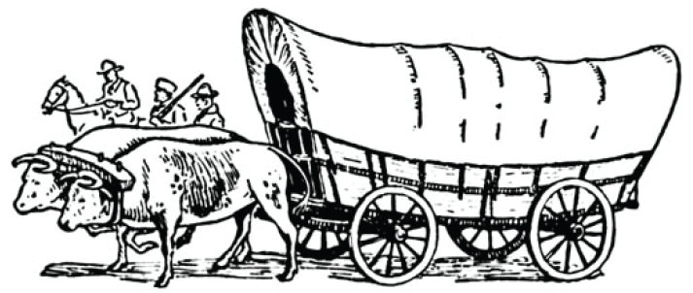
What's in Your Wagon?
(presentation part 2)
Environments and Cultures
How does the "cultural baggage" from an eastern environment fit a western environment?
U3, L1, S2b

Slide 2
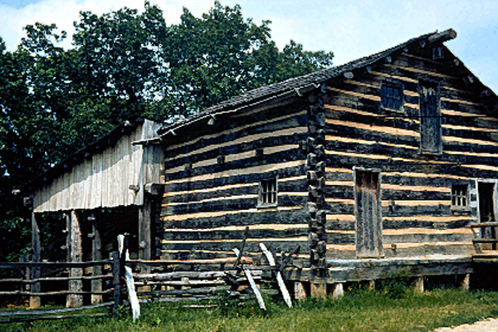
Suppose you grew up in this log cabin, but you decided to move west
in order to claim a free homestead on the frontier.

Slide 3
It's the late 1800s, and your family wants to move west to nearly free land.
- - - - - -
You have used two worksheets
"What's in Your Wagon" (Part 1 and Part 2-Step 1)
to plan what to take along.
You should have used two Worksheets.

Slide 4
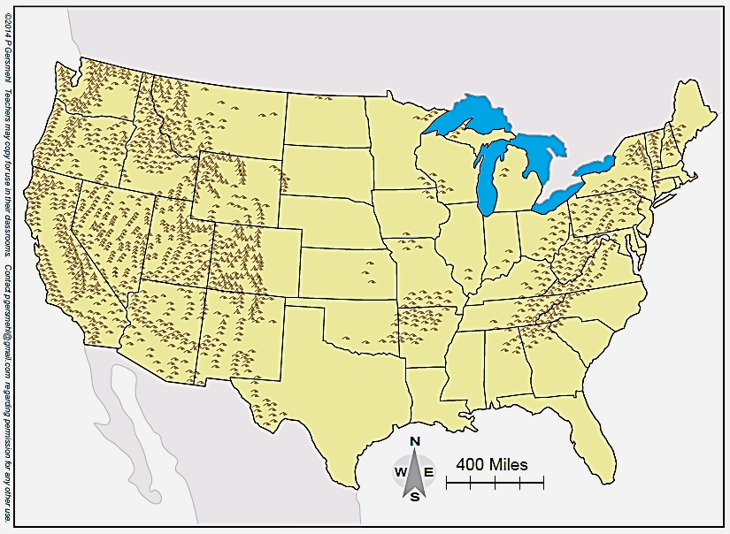
Imagine that families leave homes in Ohio.
Numbers 1, 2, and 3 show places in the western frontier where they will find nearly free land.
3
2
1
Which place in the western frontier would your family choose?

Slide 5
This presentation pauses briefly while the wagons travel west.
The Part 2 Worksheet (second page)
suggests some problems and opportunities encountered during a journey.

Slide 6
During the journey west, you encounter some problems and opportunities.

Slide 7
And a big question:
What will families see in the new, western environment?
What happens when you move to a different physical environment?

Slide 8
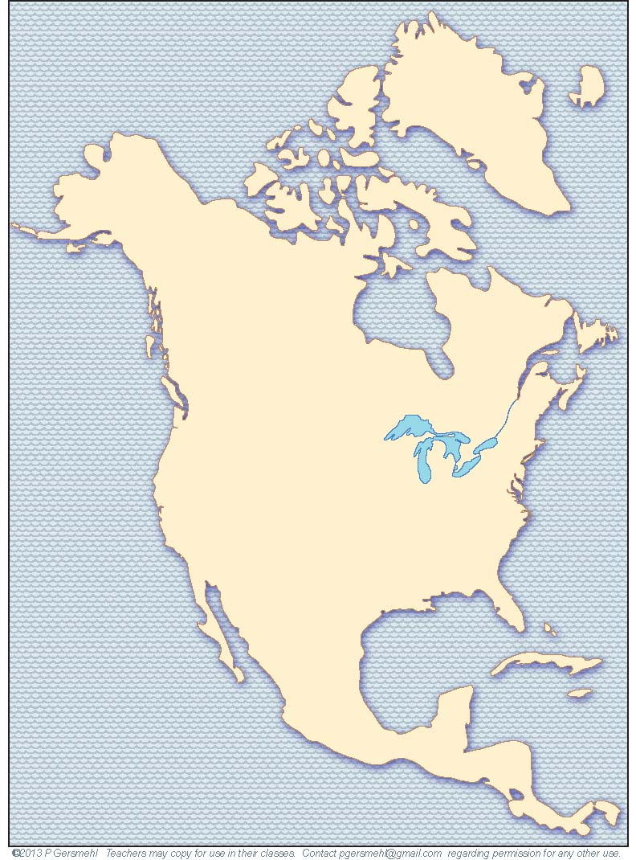
Remember
when you divided North America
into regions?
Check your work maps or journal notes to see the full names of these two regions
West
East

Slide 9
The Rainy East gets enough precipitation for trees.
Semi-Arid
Rainy East
The semi-arid Great Plains get less precipitation than trees need.
Therefore, there are more trees in the "Rainy East."

Slide 10
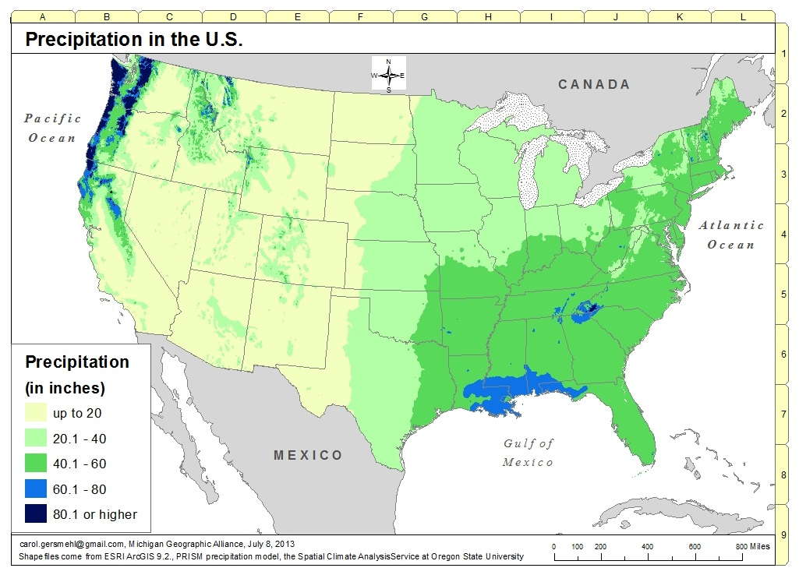
3
2
1
The wagons moved westward from an eastern region that received more precipitation to a western region that received less.

Slide 11
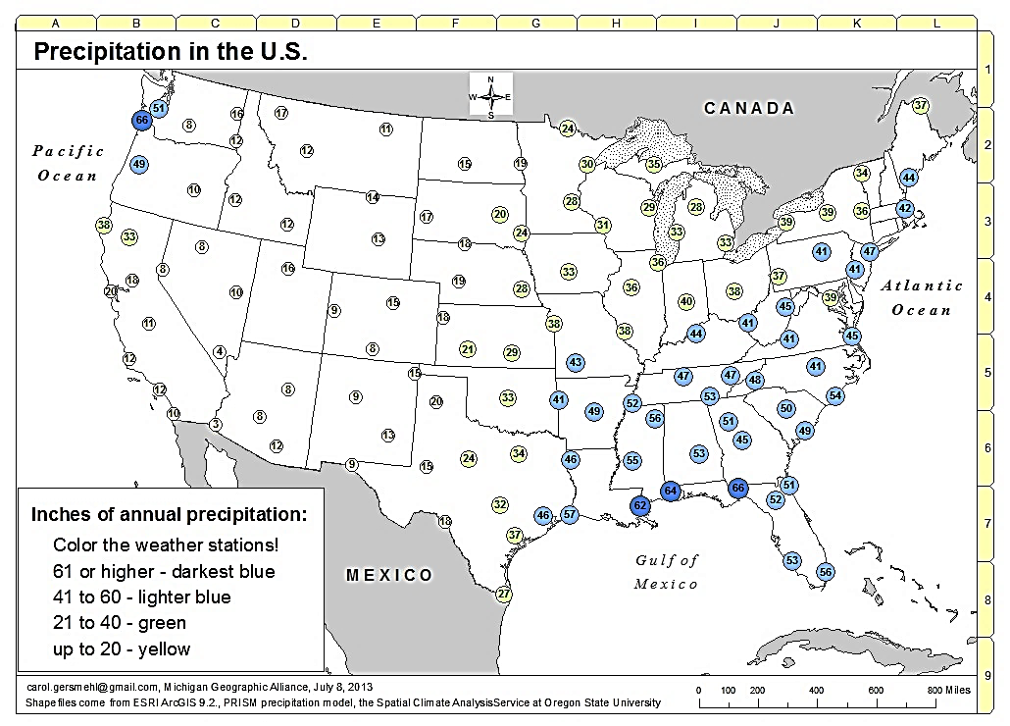
(Selected Weather Stations)
E
D
3
C
2
1
B
A
Numbers in circles show amount of precipitation.
In this example, wagons moved westward from an eastern region that received more than 36 inches of precipitation to a western region that received less than 20 inches.

Slide 12
You have arrived in the "semi-arid" Great Plains.
Question –
What does this new environment look like?

Slide 13
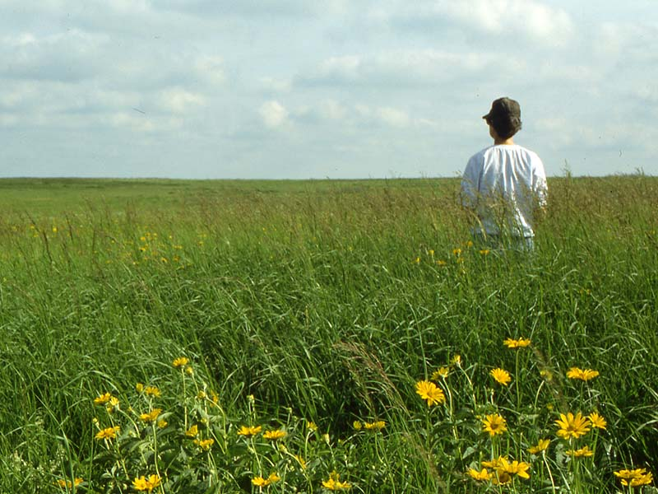
Question –
how many of the "forest" tools and skills
are useful
in this environment?

Slide 14
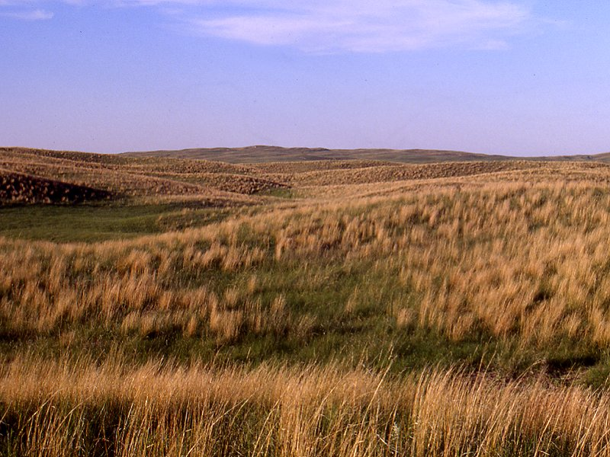
Question –
How many of the "forest" tools and skills
are useful
in this environment?
Most of the middle of the United States
is a natural grassland, too dry for trees.
Out here, an axe, corn planter, cider press,
shallow-well pump, and single-shot rifle
are about as useful as an airplane made of bricks.

Slide 15
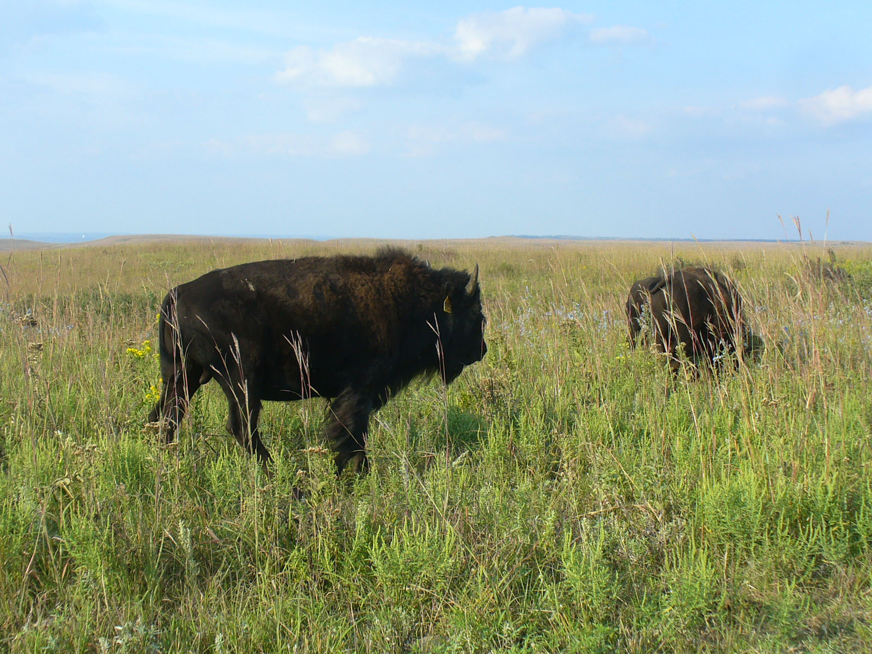
Even the animals out here
(IF you can get close to them)
are not likely to fall after a shot
from a front-loading deer rifle.
In many years, you will be able to grow food crops (wheat) that are shorter than corn. Wheat (like these shorter grasses) needs less precipitation than corn.

Slide 16
DEFINITION
Culture – shared ideas about how to behave
and the tools needed to use those ideas.
DEFINITION
Culture shock – what you feel when you go into a place where your cultural ideas do not fit the environment.
Several of your tools do not fit the new environment!

Slide 17
DEFINITION
Culture – shared ideas about how to behave
and the tools needed to use those ideas.
DEFINITION
Culture shock – what you feel when you go into a place where your cultural ideas do not fit the environment.
DEFINITION
Cultural adaptation – changing your ideas to fit the conditions around you better.
Finding or inventing tools that work!

Slide 18
Your family has moved west.
- - - - - -
See Step 4 in the worksheet
"What's in Your Wagon" (Part 2)
a. How is the destination environment different from your original home?
b. How well do the tools in your wagon (that came from the “Rainy East) fit this destination environment?

Slide 19
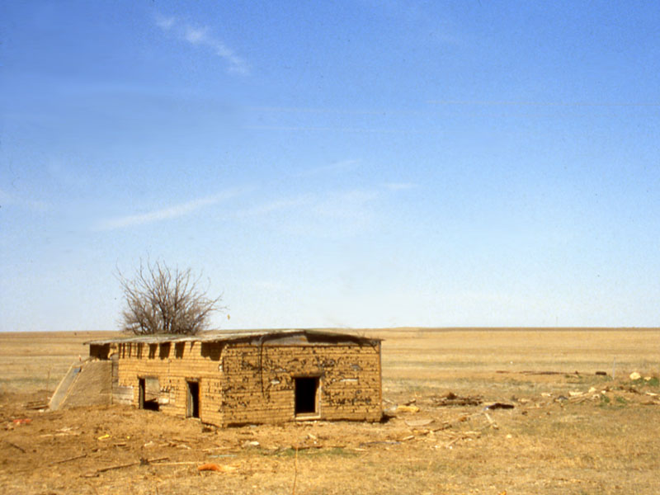
In a grassland, people had to build houses out of something else besides wood
(unless they could afford to ship some in).
This is a sod house (one made mostly of grass and dirt).
It does not look like
a nice place to live,
BUT . . .
Pieces of sod look like bricks that have dry grass on top and dry soil below.

Slide 20
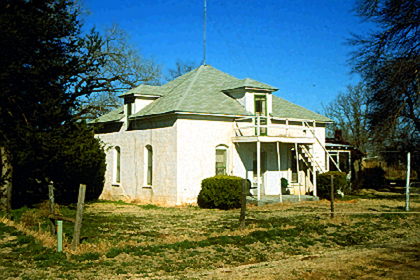
This is also a sod house.
It is an example
of a better kind
of “sod-house culture.”

Slide 21
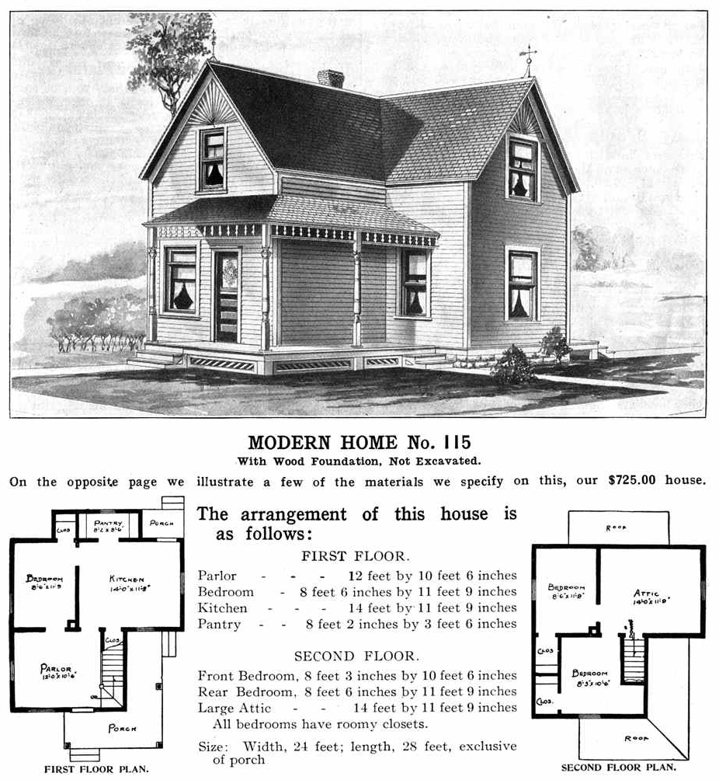
Later,
(after railroads were built across the Plains)
companies like Sears
shipped the materials
to build the kind of houses
you see all over the "Semi-Arid West."

Slide 22
People needed to invent new tools
to live comfortably in a dry grassland environment.
Can you think of some inventions that might be needed?
You have free land, but
what will do for food, water, shelter, and safety in this new environment?

Slide 23
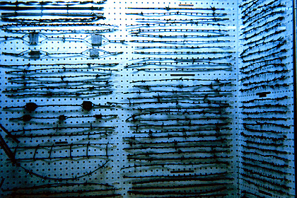
Go into any county historical museum
in the Great Plains states, and you will see evidence
of the pride that people have in their inventiveness.
This is a display of some of the 700+ patents
for different kinds of wire fence.

Slide 24
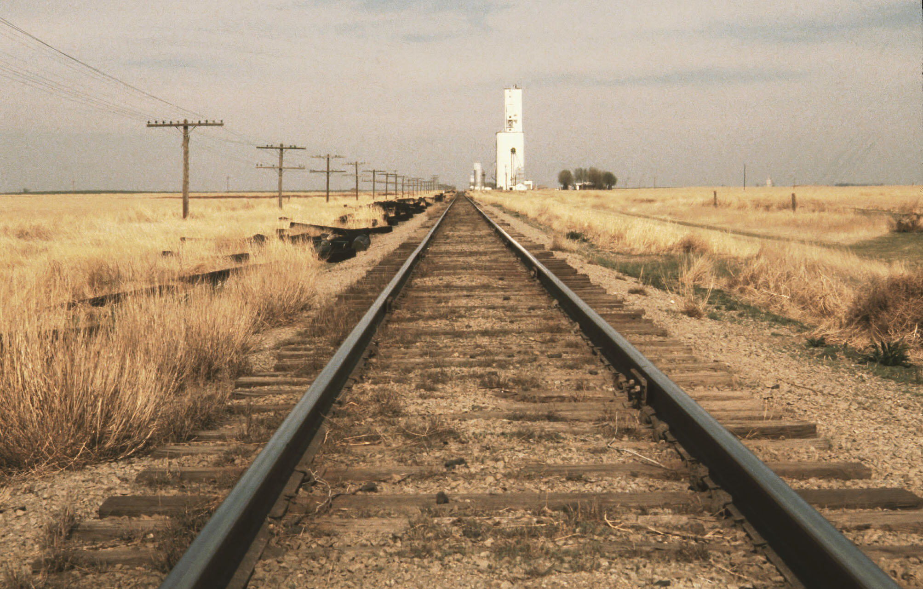
One of the most important inventions
cannot fit in a museum, but you can see it
running through nearly every town in the region –
a railroad to haul wheat to customers in faraway cities
(and to bring wood and other supplies back to the farmers).

Slide 25
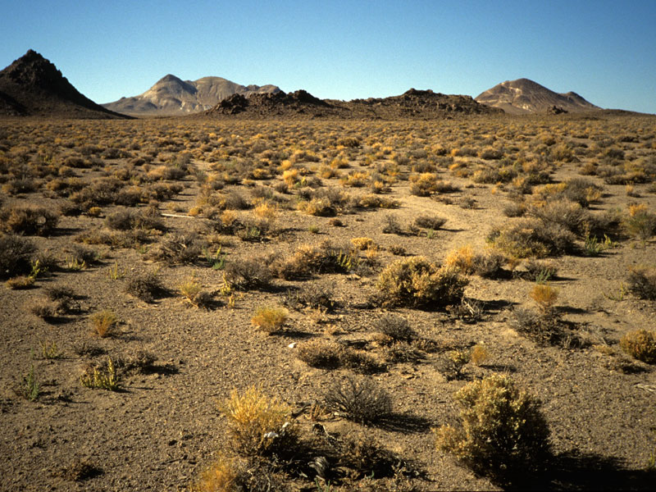
Go still farther west, and the climate gets even drier.
Eventually, even the best inventions were not enough.
Very few people live in the very dry regions,
because there is not enough rain or snow to support
a continuous plant cover (or a large animal population).

Slide 26
In Walter Prescott Webb’s book, The Great Plains,
you can read the stories of many discoveries and inventions
that people needed to live comfortably in a dry grassland environment.
Here are some of the inventions (adaptations to the new environment):
Wheat – a crop that can grow with less rain than corn needs.
Steel plow – a tool that can work in dry soil full of grass roots.
Longhorn cow – an animal that could eat dry, tough grasses.
Barbed wire – to keep the longhorns from eating your wheat.
Fencing pliers – to hold, cut, stretch, and attach barbed wire.
Deepwell pump – to bring water up hundreds of feet.
Windmill – to run the deepwell pump (it’s really windy out here!)
etc.
Repeating rifle – to hunt and defend in a treeless environment.

Slide 27
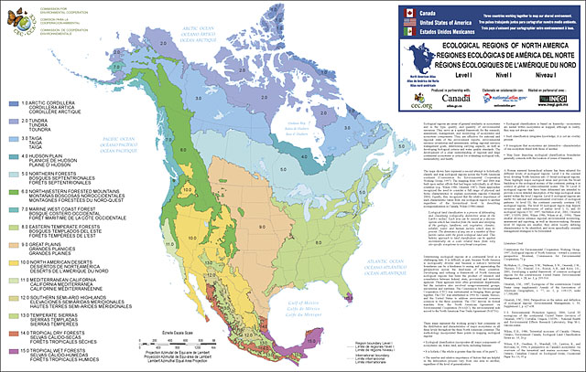
What’s the moral of this story?
When you see a map that uses lines and colors
to mark areas it calls “forest,” “grassland,” and “desert,”
you know people need different tools and cultural ideas
in order to make a living in these different environments.

