Slide 1
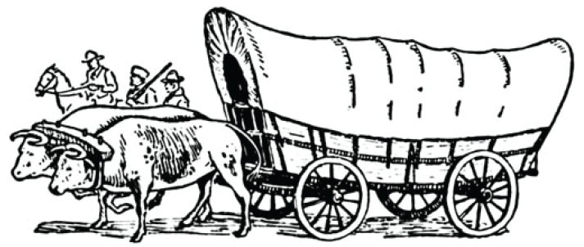
U3, L1, S2b
What's in Your Wagon?
(presentation part 1)
Environments and Cultures
Suppose you are living
in the late 1800s
in the Eastern U.S.

Slide 2
It's the late 1800s, and your family wants to move west to nearly free land.
You must decide what to take along in one wagon. - - - - - -
What would you carry in your wagon?
-- -- -- -- -- --
Let's first see pictures of the physical environment in the eastern U.S. where you live.

Slide 3
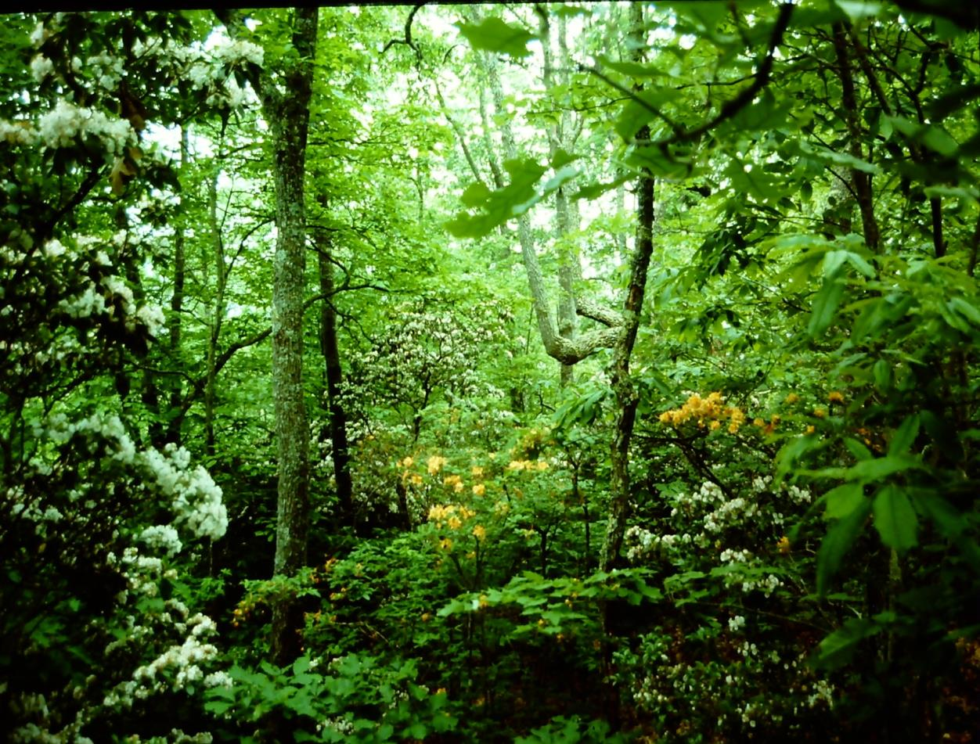
When Europeans arrived in the 1500s,
most of eastern North America was covered by forest.
The forest was especially thick on steep slopes.

Slide 4
In many places, the forest was more open,
because Native American people often set fires
to burn brush and make conditions better for animals.

Slide 5
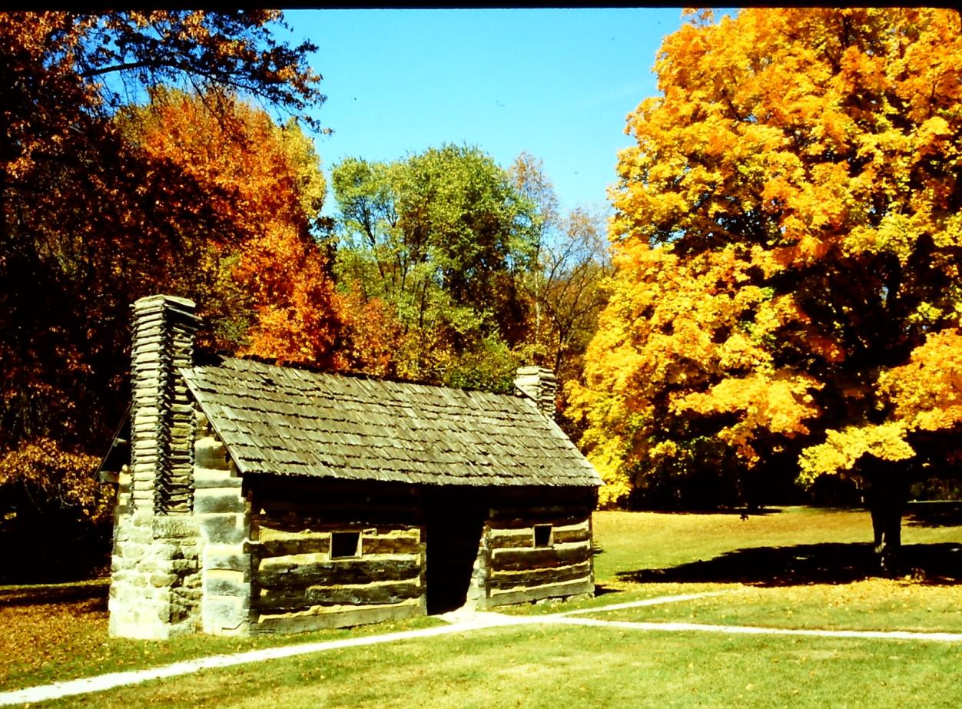
Most people who lived in a forest region
(like Europe or eastern North America), had learned how to use the forest. They built homes using logs, and made roofs using wooden shingles.

Slide 6
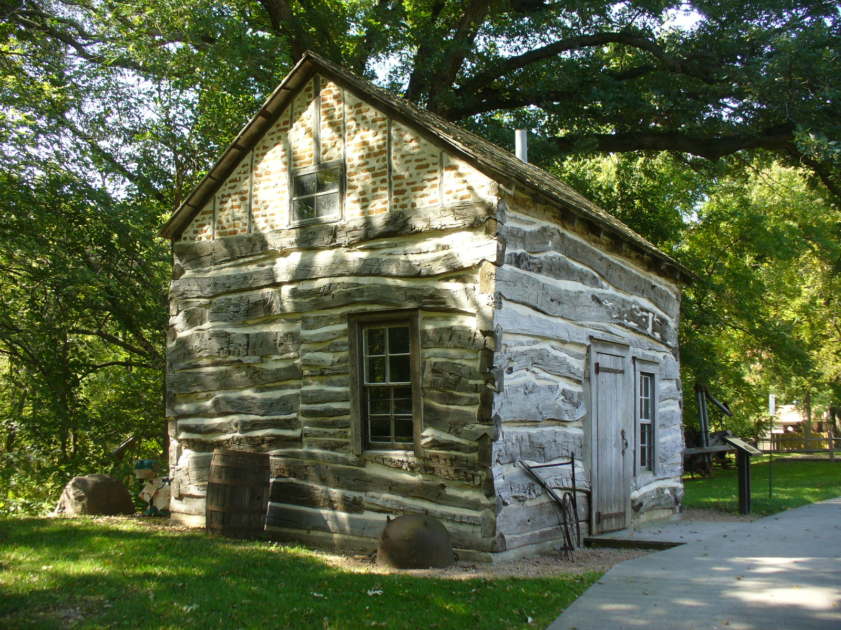
This cabin doesn’t have "neat," straight lines, BUT
it is actually an example of superior log cabin culture.

Slide 7
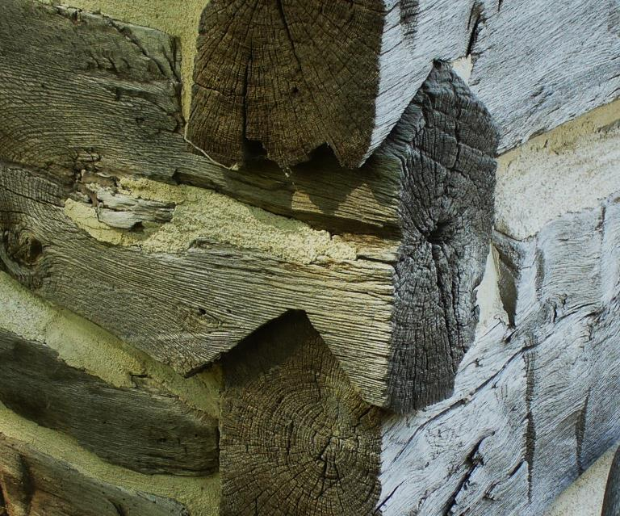
Note that the log ends are upside-down Vs.
These require more time and skill to make,
but they shed rainwater better and last a lot longer.

Slide 8
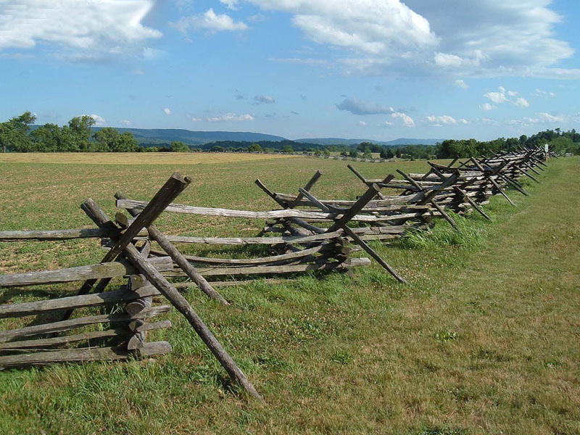
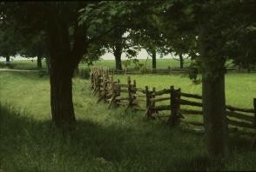
It’s the same with fences.
The one on top
is easier to build fast,
but the one below
is more effective
and uses less wood
per mile of fence.

Slide 9
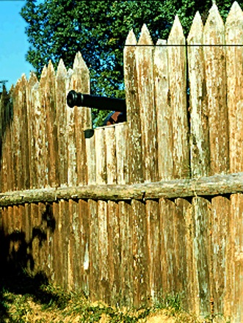
Everywhere you look
in eastern North America,
you see evidence
of cultural ideas
that used materials that were abundant in a "forest" physical environment.

Slide 10
DEFINITION
Culture (n) – shared ideas about how to behave
and the tools needed to use those ideas.
People who lived in forests had developed a culture (tools and mental rules about how to use them)
that used what was available in a forest environment.

Slide 11
It's the late 1800s, and your family wants to move west to nearly free land.
You must decide what to take along in one wagon. - - - - - -
What would you carry in your wagon?
Use a worksheet "What's in Your Wagon" (Part 1)
to plan what to take along.

Slide 12
The culture of people who lived in forests:
These tools and mental rules about how to use them are useful in forest environments.
Axe – to chop trees down, to clear fields for corn, and to build cabins.
Saw – to cut logs to length, and to turn logs into boards for building.
Wedge – to split logs into rails for fences and corrals.
Froe – to split logs into thin sheets for roof shingles and boards.
Whetstone – to sharpen axes, saws, froes, and other tools.
Firebrick – to line a chimney for a wood-burning stove or fireplace.
Nails – to fasten boards together in buildings, furniture, wagons, etc.
Hammer – to drive nails (or to pull them out to be reused).

Slide 13
These cultural tools work well in a forest environment:
Corn seed – and plow, harness, planter, corn knife, husking tool.
Apple seed – trimming saw, ladder, pail, corer, cider press, bottles.
Cotton seed – gin, spinning wheel, loom, scissors, needles.
Long Rifle – lead, bullet mold, powder, keg, sling, repair parts.
Well – shovel, spade, tile mold, pump, pipe, pail, dishpan, bathtub.
Cooking pot – flint, steel, hatchet, fire grate, wood stove, ash bin.
Candle mold – tallow tub, fire grate, wick trimmer, candle holder.
and so on – lots of tools, lots of mental rules, lots of skill.

Slide 14
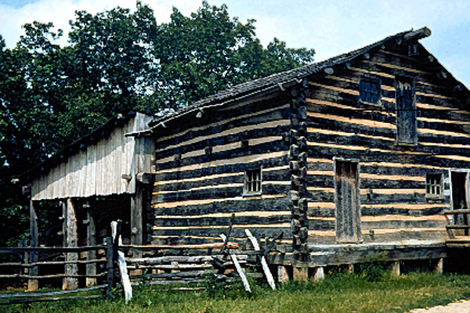
So let’s stop and ask a key question:
If you grew up in this log cabin, but you decided to move west
in order to claim a free homestead on the frontier,
What would you take in your wagon?

Slide 15
It's the late 1800s, and your family wants to move west to nearly free land.
You decided what to take along in one wagon. - - - - - -
Use the second worksheet: "What's in Your Wagon" (Part 2-Step 1 on first page)
to plan what to take along.

