Slide 1
Regions in North America
and
their
physical environment characteristics
U3, L1, S2b
North America
Part 2
Review

Slide 2
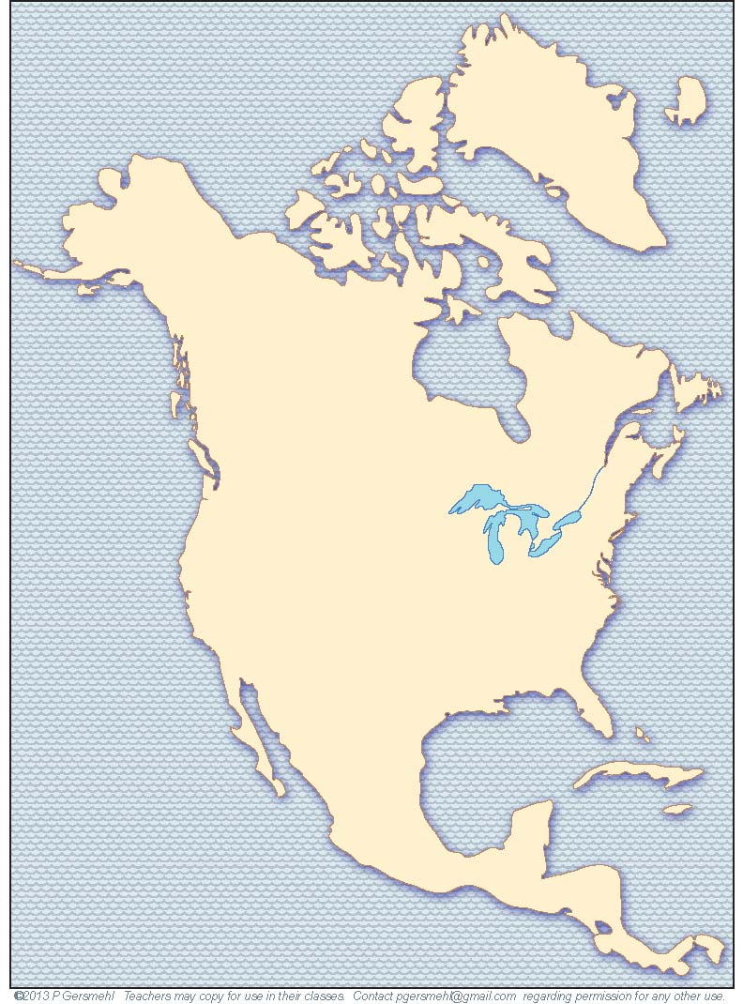
What will we review?
Names of regions
in North America
---
Characteristics of regions in North America

Slide 3
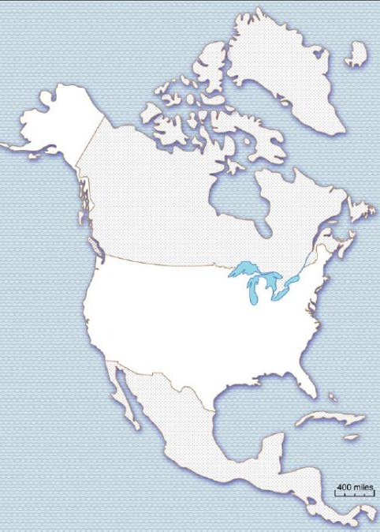
Use a workmap along with this presentation:
As we review regions with the next slides:
Write each region name on your work map.

Slide 4
REVIEW:
We drew four lines and divided
North America
into regions:
1
Western
Mountain region
1
Write the region name on your
workmap.

Slide 5
We drew four lines and divided
North America
into regions:
2
2
Northern
Cold
region
1
Write the region name on your
workmap.

Slide 6
We drew four lines and divided
North America
into regions:
2
3
Great Plains
Grass
region
3
1
Write the region name on your
workmap.

Slide 7
We drew four lines and divided
North America
into regions:
2
4
Southern
Cotton/pine region
3
1
4
Write the region name on your
workmap.

Slide 8
We drew four lines and divided
North America
into regions:
2
5
Great Lakes
Farm and Factory
region
3
5
1
4
Write the region name on your
workmap.

Slide 9
We drew four lines and divided
North America
into regions:
2
Write the region name on your
workmap.
3
5
1
6
Central American
and Caribbean
hot and hilly
region
4
6

Slide 10
We drew four lines and divided
North America
into regions:
2
1. Western mountain region
2. Northern cold region
3
3. Great Plains grass region
5
1
4. Southern cotton/pine region
5. farm and factory region
4
5. Great Lakes farm region
6. Central American
and Caribbean
hot and hilly region
6

Slide 11
Can you remember
the main
Physical Environment
characteristic
of each region?
2
3
5
1
4
6

Slide 12
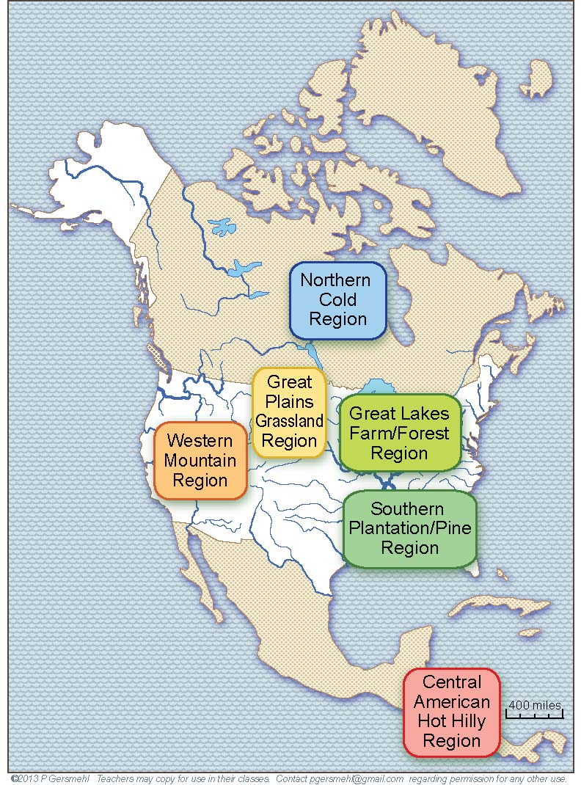
Find an important
Physical
Environment
characteristic
in each region name.

Slide 13
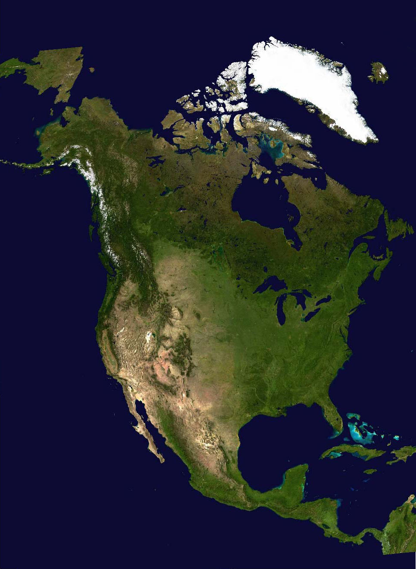
Here, we draw
the same four lines
on a satellite image.
How does the image help you remember what each region
is like?

Slide 14
We make regional maps when we put similar places together.
(And we decide what is a similar place!)
Here are several physical environment conditions that affect how people live and make a living:
a. High and rugged mountains
b. Places that are too cold for farms
c. Places that are warm enough for farms but too dry for trees, d. Places with enough rain and a growing season that is long enough for cotton
(and therefore probably had slavery)
In other words, these four lines help us organize a lot of information.
This is why we recommend memorizing where these lines go.

Slide 15
Here are
some photos
and key facts
about each region.
You will use photos
to look for several facts
about each region

Slide 16
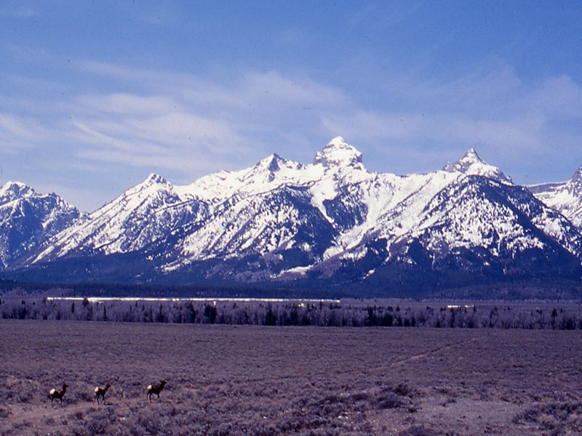
Western Mountain Region: younger rocks and high mountains
In the photo, find the following:
_ snow on the highest mountain peaks,
_ forests on lower slopes, _ dry grasslands or deserts
in the low valleys between mountains

Slide 17
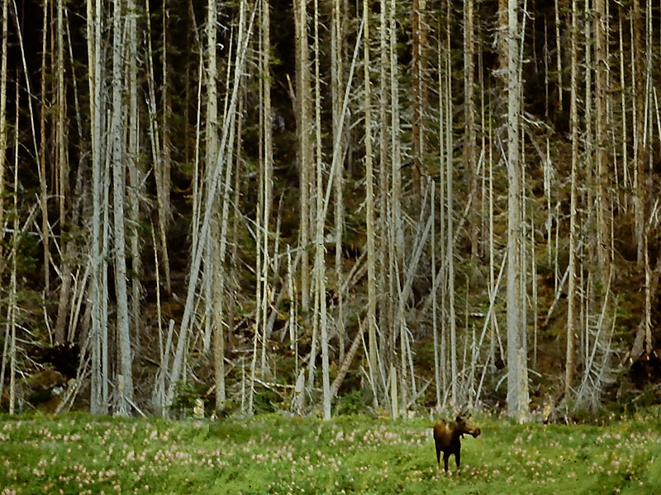
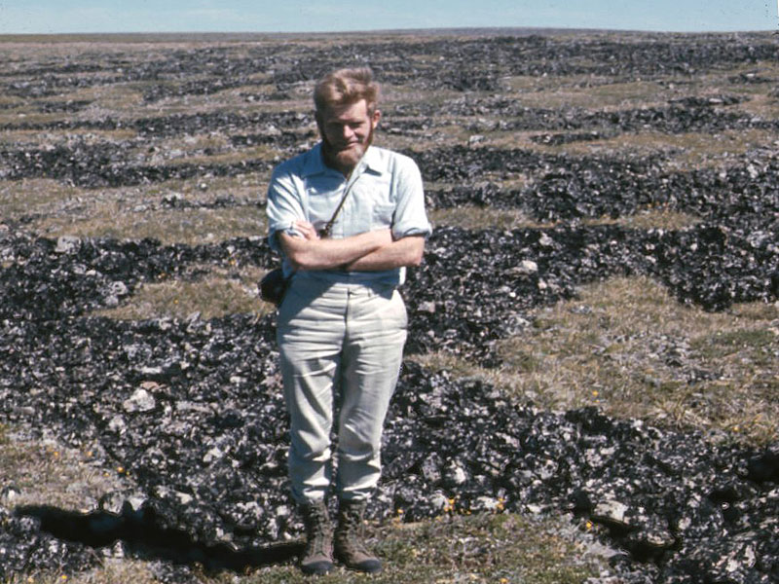
Northern Cold Region: shortest summers, longest winters
In the photo, find the following:
_ slow-growing needleleaf trees
OR _ tundra with no trees
_very few people, _few farms .

Slide 18
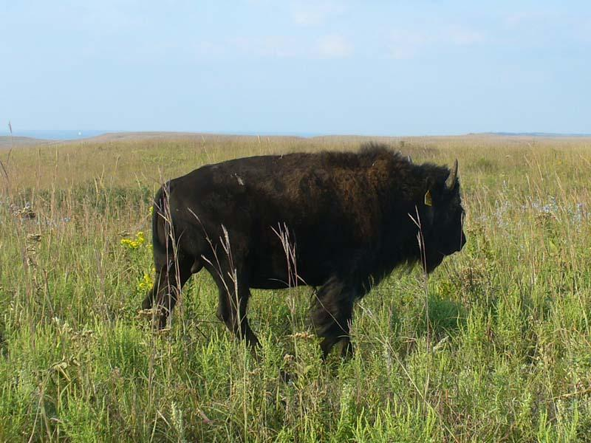
Great Plains Grassland Region: semi-arid grasslands
In the photo, find the following:
_ flat plains or low hills,
_ grassland vegetation,
_ bison, _ few people.

Slide 19
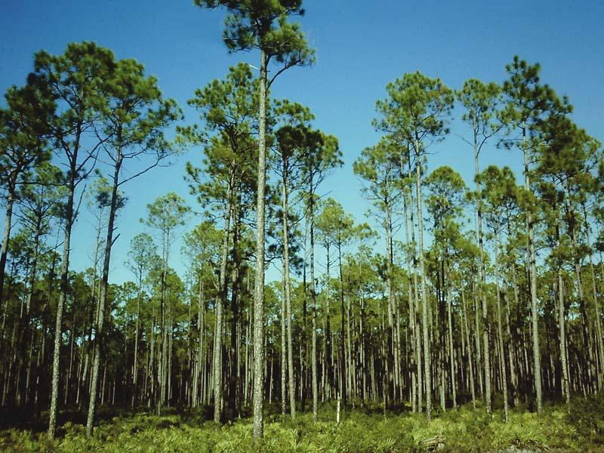
Southern Plantation and Pine Region:
long summers, mild winters, and long growing season
In the photo, find the following:
_fast-growing forest, _planted pine trees (to be used to make paper and lumber).

Slide 20
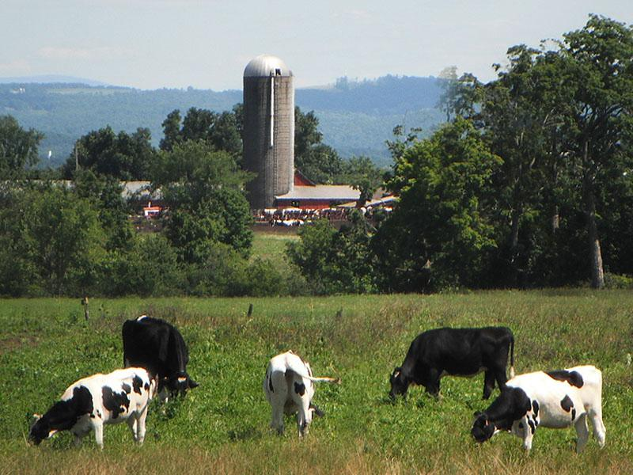
Great Lakes Forest/Farm/Factory Region: cold winters, warm summers
In the photo, find the following:
_ hardwood forest, _ dairy cows, _low hills

Slide 21
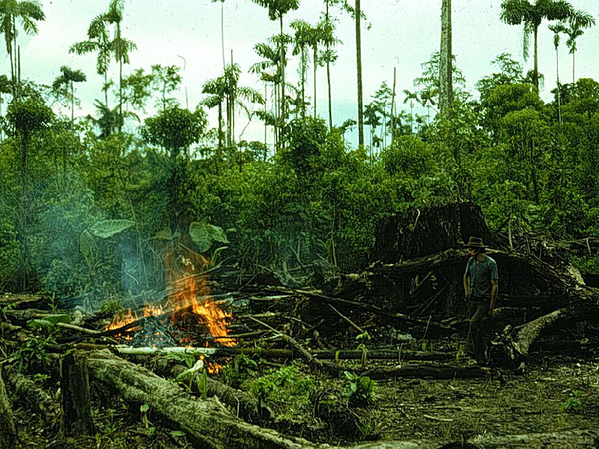
Caribbean/Central American Region: no freezing season, much rain near oceans
In the photo, find the following: _ tropical forests,
_ slash-and-burn farming

Slide 22
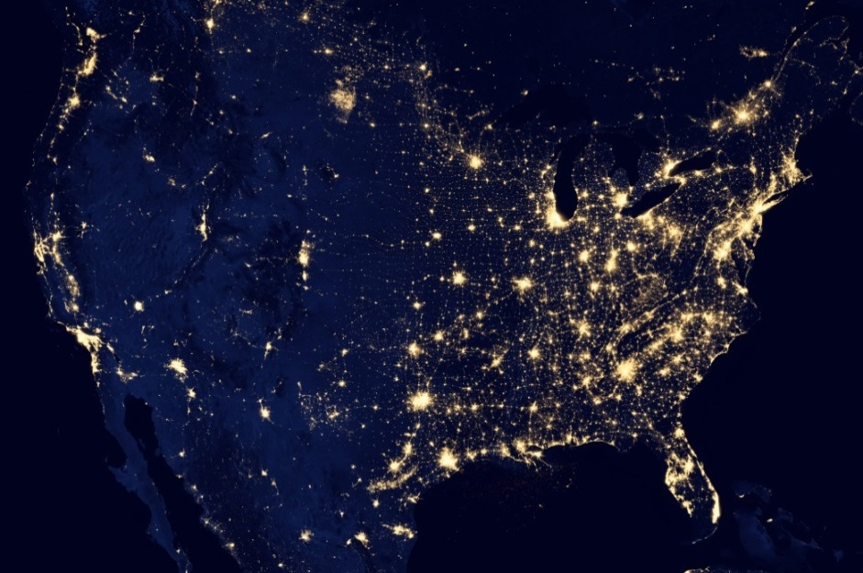
Here are the daytime and
night-time satellite images again.
Can you “see” the regions
in your mind?
Click and we’ll draw them again.

Slide 23
Here are the daytime and
night-time satellite images again.
Can you “see” the regions
in your mind?
Click and we’ll draw them again.
Remember, this
is a big oil field!

Slide 24
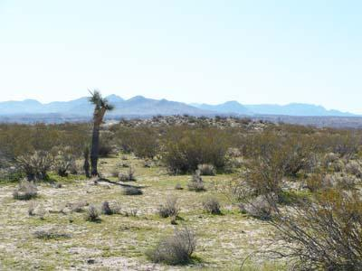
People disagree about how many regions we should show inside the Western Mountain Region.
Some people want
the map to show
a hot, dry region called
the Arid Southwest.

Slide 25
Remember that deserts
fill most of the low lands
between mountains in the Western Mountain Region.
In contrast, in the high mountains there is enough rain
for trees
(even in dry Arizona).
For part of the year,
there also is snow in the high mountains.

Slide 26
Comparisons with other parts of the world:
In our maps,
we will use
these six regions
when we compare
other continents or world regions
to North America.

Slide 27
Remember, a geographic region
is not a “real thing” out there.
A "region" is what we get when we draw lines
to put similar places together into groups.
(We want to make them easier to remember).

Slide 28
We draw lines
to put similar places together into groups.
We use a criterion (a characteristic or a measure) to divide things into groups.
If we use different ways of deciding (a different criterion)
what places are similar to each other,
then we get different regions.
As a result, we can make maps
of many different kinds of regions:
rock regions, forest regions, crop regions, industrial regions, language regions,
sports regions, political regions, tourist regions,
voting regions, even religious regions.

Slide 29
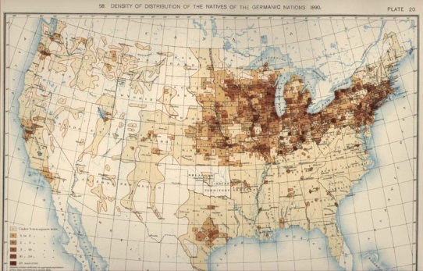
An optional section
about map
comparison:
We said these region lines were associated
with many other things in U.S. history.
Here is a map of German immigrants in 1898.
Click to draw some of the regional lines:

Slide 30
An optional activity
about regions on maps:
Other regional maps:
On the internet, you can find maps that show regions of religions:
http://www.glenmary.org/rcms2010

