Slide 1
Regions in North America - Regions help us organize our knowledge North America
U3, L1, S1d
North America
Part 1

Slide 2
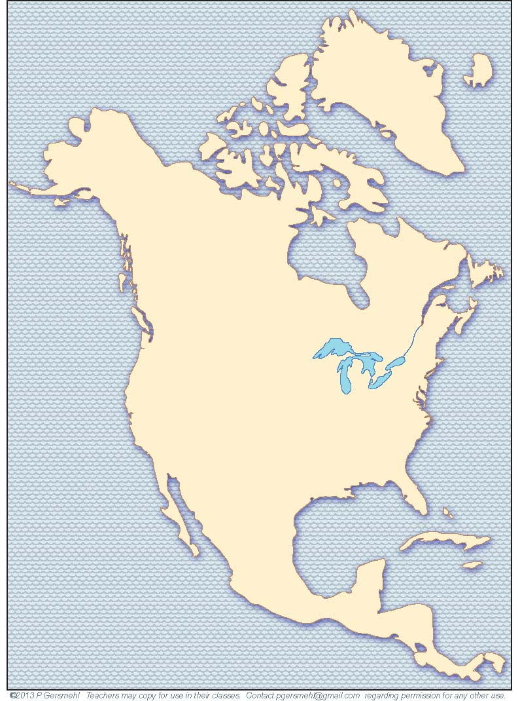
We will find different regions
inside North America.
Each region provides different opportunities for people to make a living.

Slide 3
Definition: a region is a group of places
that are like each other
and close to each other
If you draw a line around the places,
the result is a regional map.
Why do we make regional maps?
Our regional map will help us
remember
different
environments
in North America.
Often, it's easier to remember
the general shape of a region,
rather than the locations
of many individual places.

Slide 4
The continent
of North America
extends almost
from the Equator
to the North Pole.

Slide 5
The southern tip is about 7 degrees of latitude away
from the equator.
That’s only
about 500 miles.

Slide 6
The top of Greenland
is about the same
distance (500 miles)
from the North Pole.

Slide 7
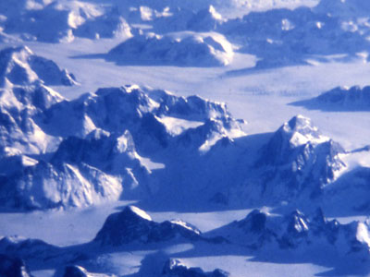
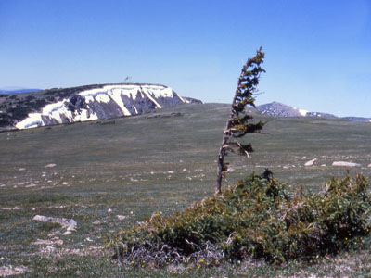
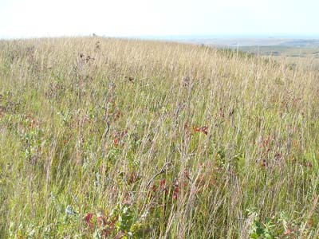
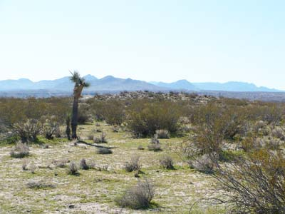
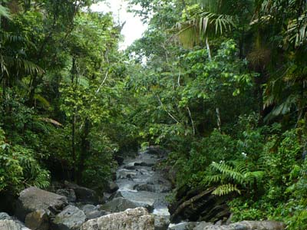
As a result,
North America
has a wide range of
natural environments,
including:
- frozen ice
- wind-swept tundra
- waving grassland,
- hardwood forest,
- tropical deserts,
- dense rainforests.

Slide 8
Regions in North America
Regions have different physical environments,
and physical environments affect how people live and make a living.
Regions help us study Human – Environment Interaction.
-

Slide 9
In this presentation
we will draw
a few simple lines
to help organize
our knowledge
about regions in North America.

Slide 10
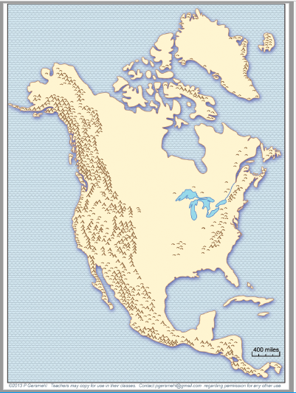
You will draw lines on a base map. (Use the work map that shows
mountains.)
You'll need a pencil and a straight edge (e.g., a ruler).

Slide 11
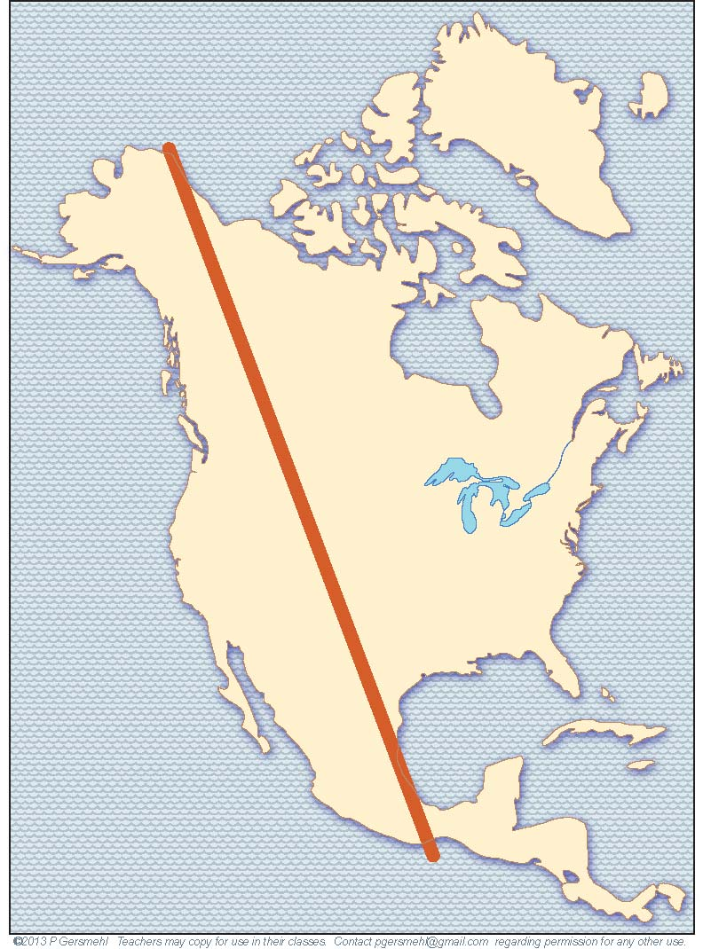
The first line starts at
the northern tip
of Alaska
(near a tiny town
called Barrow).
Draw
Line 1
It goes
on a long diagonal
through the continent
to the east coast
of central Mexico.

Slide 12
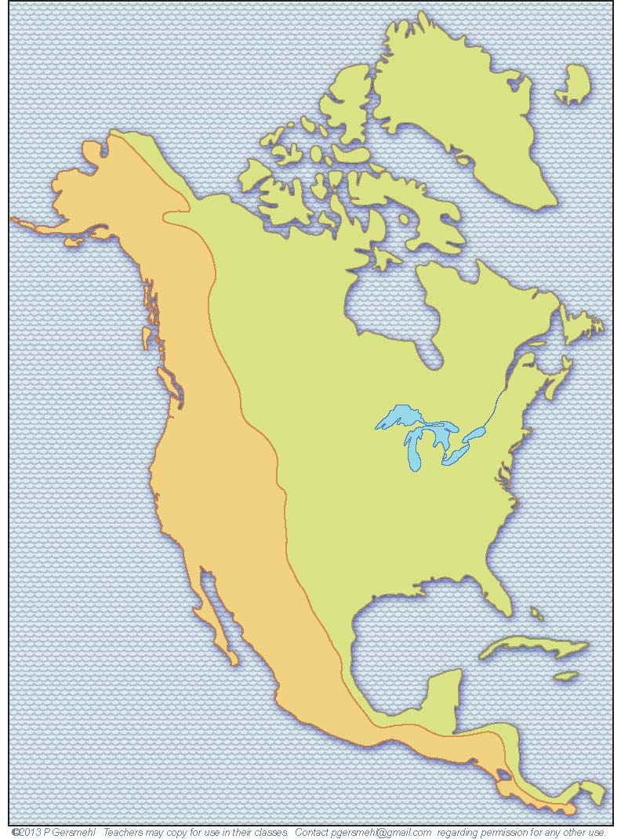
This line is a
generalization.
It traces
the general position
of our first two regions.

Slide 13
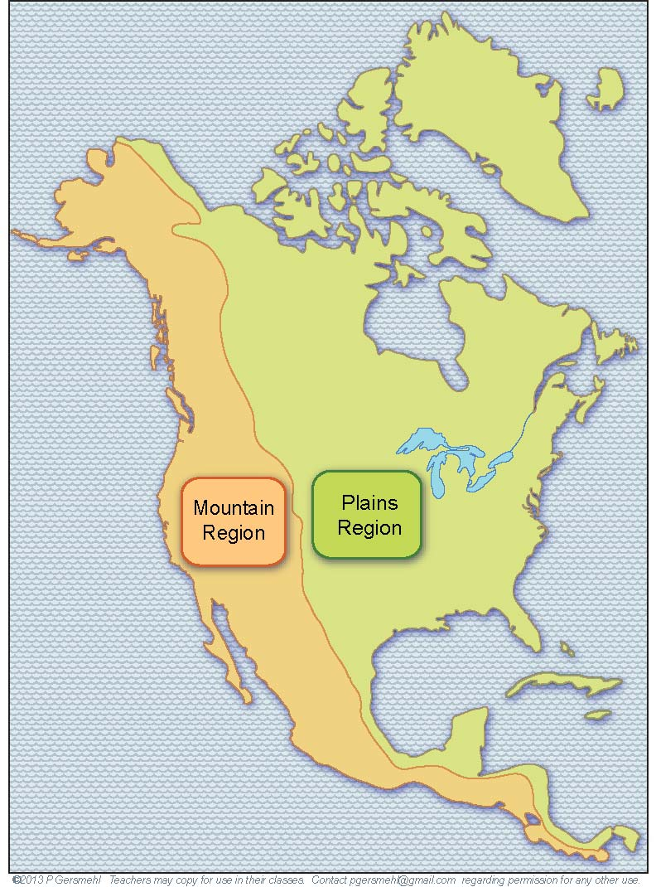
1.
Mountain West:
younger rocks,
higher land, and
steeper slopes
2.
Lowland East:
older rocks, low hills,
and
large, nearly flat plains.
In your journal, list the first two regions and their terrain (shape of the land) characteristics.

Slide 14
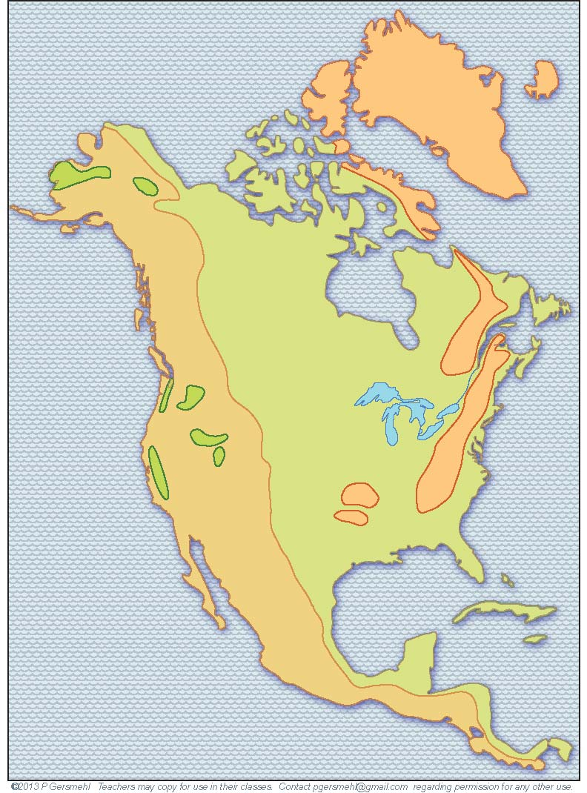
The real world is more complicated.
Regional generalizations
usually have some exceptions.

Slide 15
Here are three important exceptions (small green areas on the map)
in the West.
Willamette Valley
(end of the Oregon Trail)
Snake River Plain
(potatoes for French fries)
Central Valley of California (most productive
food-growing area in the U.S.)

Slide 16
Important exceptions
in the East:
The cold highlands of Greenland
(and nearby islands)
The Appalachian “Mountains”
(western edge of the 13 colonies)
and many scattered
areas of low hills
(left by the glaciers long ago).
The Ozark “Mountains”
in Missouri and Arkansas

Slide 17
You do not need to remember
the exact position
of these exceptions.

Slide 18
You should
remember the line that
divides the continent
into these two regions:
1 - Mountain West
and
2 - Lowland East
(with a few exceptions in each region!)

Slide 19
And you should
be able to draw
a dividing line
in your mind
when you see
a blank map
on the Internet,
in a newspaper,
or on TV.

Slide 20
Next, we focus on the
Lowland East,
and we will separate the Lowland East into several regions.

Slide 21
A second line
runs east-west
through the northern edge of the Great Lakes.
The 2nd line stops when it reaches
the mountains.
Draw
Line 2

Slide 22
North of this line,
it can freeze in June,
and the growing season
is therefore too short
for most food crops.
Very few farms
Note:
In the
Western
mountains, high peaks
are usually cold
while low valleys
can be warmer.
South of this line, the
growing season is long enough so farmers can grow
food crops (including wheat and corn).
Many
farms

Slide 23
In your journal, list these two regions and their characteristics.
Very few farms
Why are there few farms?
Many
farms
Why are there many farms?

Slide 24
Growing season too short for crops
Growing season long enough for crops

Slide 25
The actual line is
also a little more
complicated. It looks like a "sagging hammock."
Add the “sagging hammock”
(dashed line) to your work map.
It dips south near Lake Michigan.
It is north of the Great lakes in the East and in the West.

Slide 26
Our third line
runs due north
from the southern
tip of Texas.
Draw
Line 3

Slide 27
Our third line
runs straight north
(not leaning to the West or to the East).

Slide 28
This line divides the Rainy East
from the Semi-arid
West.
Semi-Arid
Definition: A semi-arid place is not very rainy, but not completely dry;
“semi-arid” means “half-dry.”
Rainy

Slide 29
In your journal, list these two regions and their characteristics.
The Rainy East gets more precipitation.
Semi-Arid
Rainy East
The Semi-arid West get less precipitation than trees need.

Slide 30
On the next slide,
investigate
where you see more
night-time lights.
Semi-Arid West
Rainy East

Slide 31
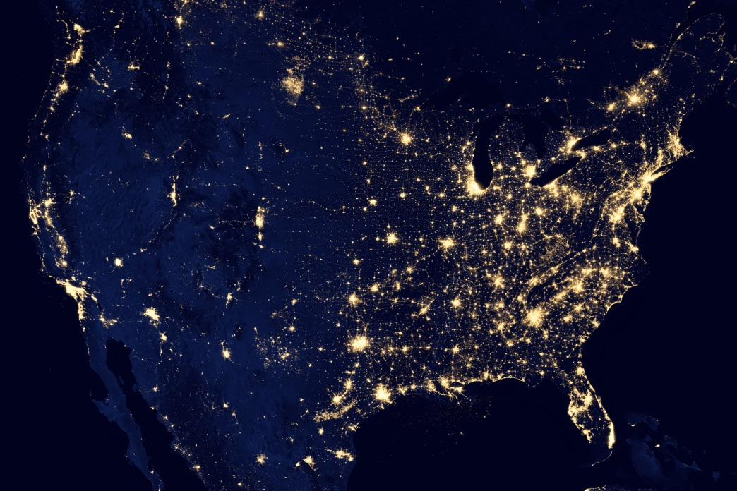
How do physical environments affect where people live?
Which region has more night-time lights?
Semi-Arid West
Rainy East
Night-time image
from NASA satellite

Slide 32
Much of the west has fewer lights, except for
urban areas near the coast.
This
lighted place
is an oil field.
Semi-Arid West
Rainy East
Night-time lights show population density.
Night-time image
from NASA satellite

Slide 33
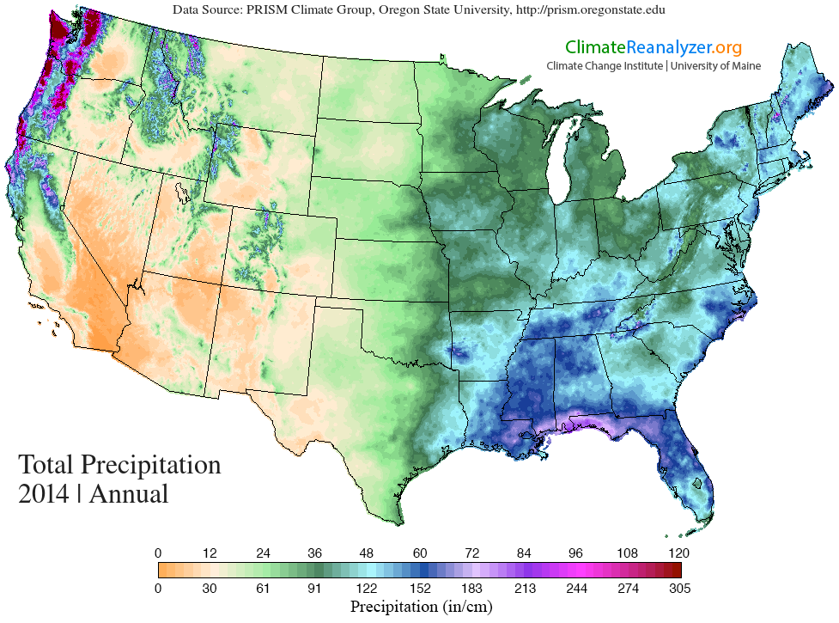
This map shows annual total precipitation.
Where are the wetter dark greens, blues, and purples?

Slide 34
Our last
important line
runs east-west
through the middle
of the "Rainy East."
Draw
Line 4

Slide 35
This line separates a shorter
frost-free season - from a longer
frost-free season (7 months or longer).

Slide 36
North of this line,
people pay more
for heating than
for air-conditioning.
South of the line,
air-conditioning
is more important
than heating.

Slide 37
This line is also
very important
in U.S. history.
South of this line
the growing season
is long enough
for cotton.
This crop is valuable,
but growing cotton
takes a lot of labor
(much more than corn or wheat).

Slide 38
Why is this line important
in U.S. history?
South of this line
the growing season
is long enough
for cotton.
Growing cotton
takes a lot of labor
(much more than corn or wheat).
Many landowners
bought slaves.
Many landowners
used slaves.

Slide 39
In U.S. history, slavery and the Civil War had long-lasting effects.
As a result,
this line still marks
important differences
in the economic and political history of the U.S.

Slide 40
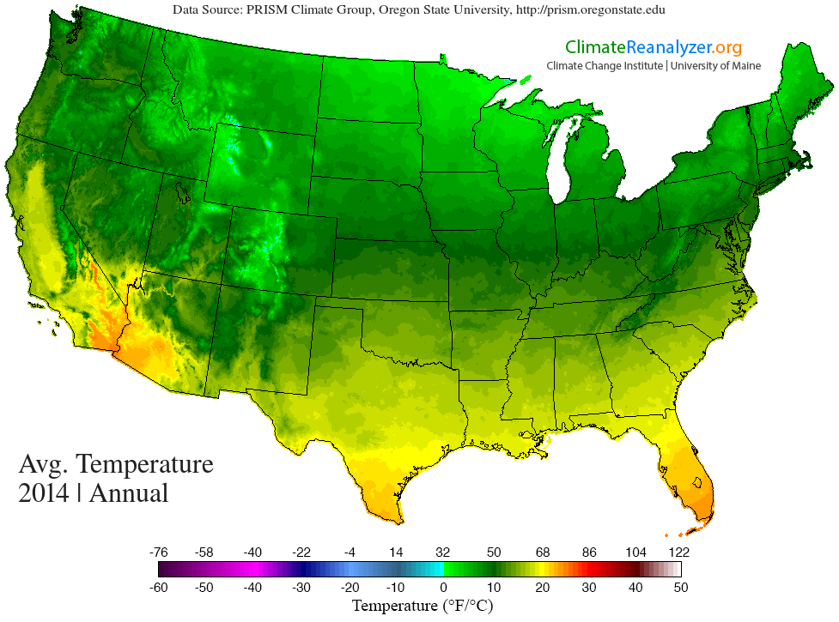
This map shows annual average temperature.
Where are the warmer yellow and orange colors?

Slide 41
In your journal, list these two regions and their characteristics.
North of this line,
was the
Corn Region in early U.S. history.
South of the line,
was the
Cotton Region in early U.S. history.
Pine trees also grow here today.

Slide 42
That’s it!
We drew four lines, and we divided
North America
into regions.
Each region provides different opportunities for people to make a living or
puts some limits
on how people live.

