Slide 1
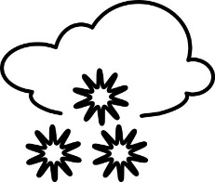
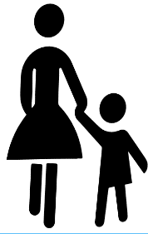
U3, L1, S1b
What is
Human – Environment Interaction?
The Physical Environment
people's activities.
affects
We will use pictures to illustrate Human – Environment Interaction.
People's activities
the physical environment.
affect

Slide 2
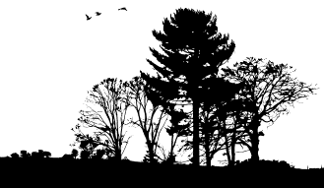
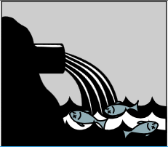
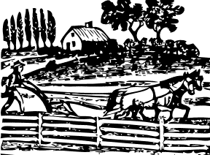
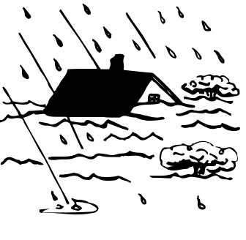
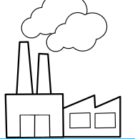
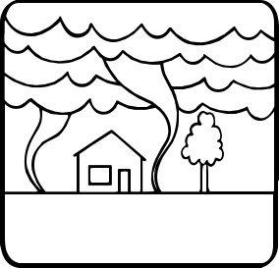
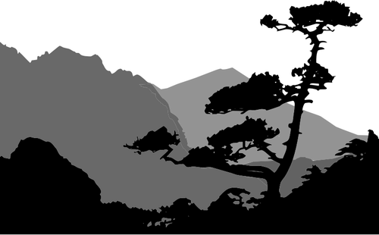
Which 3 pictures below best show ways in which the physical environment
affects
people's activities?
Explain your choices.
The Physical Environment
people's activities.
affects
A
C
G
E
D
H
B
F

Slide 3
The Physical Environment
Which 3 pictures below best show ways in which the physical environment
affects
people's activities?
Explain your choices.
people's activities.
affects
Possible answers:
A- Forest provides opportunity for lumber or a park.
B- A storm or hurricane brings too much rain and floods.
F- Tornadoes may cause damage to buildings.
H- Mountains make farming or road building harder.
A
H
B
F

Slide 4
Which 3 pictures below best show ways in which people's activities
affect
the physical environment?
Explain your choices.
People's activities
the physical environment.
affect
A
C
G
E
D
H
B
F

Slide 5
Which 3 pictures below best show ways in which people's activities
affect
the physical environment?
Explain your choices.
People's activities
the physical environment.
affect
Possible answers:
C- A sewer drains into lake water and hurts fish.
D- A factory puts smoke, particles, or CO2 into the air.
E- Farm buildings replace forest.
G- A farmer cuts down trees to make a field for raising crops.
C
E
D
G

Slide 6
Human – Environment Interaction
The Physical Environment affects people's activities.
People's activities affect the physical environment.
The Physical Environment
People's activities
affects
affect
The physical environment provides opportunities,
limitations, and hazards
that affect people's
activities.
People's activities use and modify the physical environment. People farm, mine, pollute, and preserve physical environments.

