Slide 1
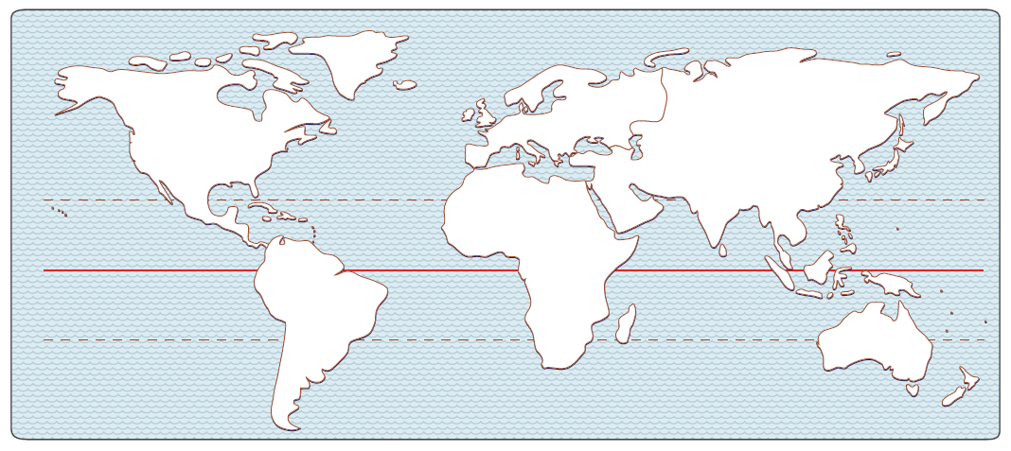
U5, L1, S1b presentation
Europe Activities Introduction and Answers for Each Activity
Students use worksheets along with this presentation.

Slide 2
Introduction to Europe Activities
Compare Europe with the U.S. and with China:
Compare number of peninsulas and amount of coastline (i.e., how complicated the coastline is):
1._U.S. _______________________________________________________________________________________________________________________
2._Europe _______________________________________________________________________________________________________________________
3._China _______________________________________________________________________________________________________________________

Slide 3
Think of
Europe as a smaller room that has many closets.
Think of
Africa as a huge room,
like a gymnasium.

Slide 4
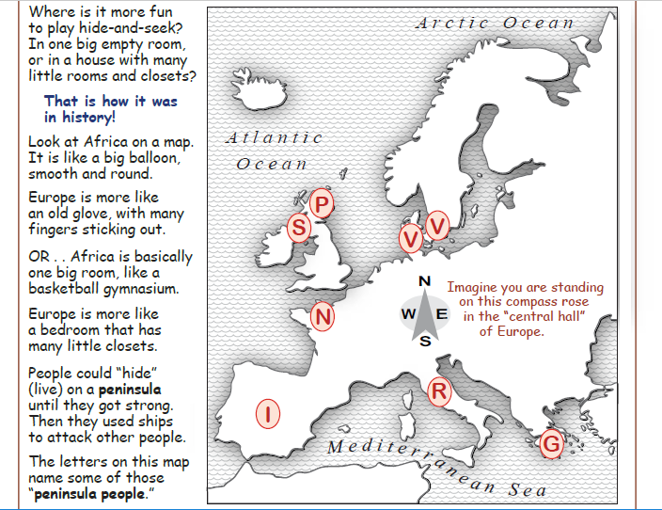
Introduction to 1st activity:
Hint: Use the compass rose.
1st activity
- - - - - - - - - -
Think of
Africa as a huge room,
like a gymnasium.
Think of
Europe as a much smaller room that has many closets (e.g., peninsulas).
North
West
East
South
Students should use the worksheet called
THE LITTLE “CLOSETS” OF EUROPE.
Answer the questions.

Slide 5
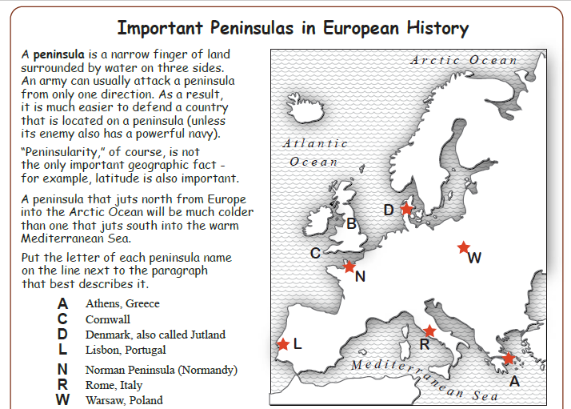
Introduction to 2nd activity:
2nd activity
- - - - - - - - - -
Have you heard of
any of the
peninsulas
shown on the map
and named on the
left?
Which letter is NOT a peninsula?
Students should use the worksheet called
Important Peninsulas in European History
Answer the questions.

Slide 6
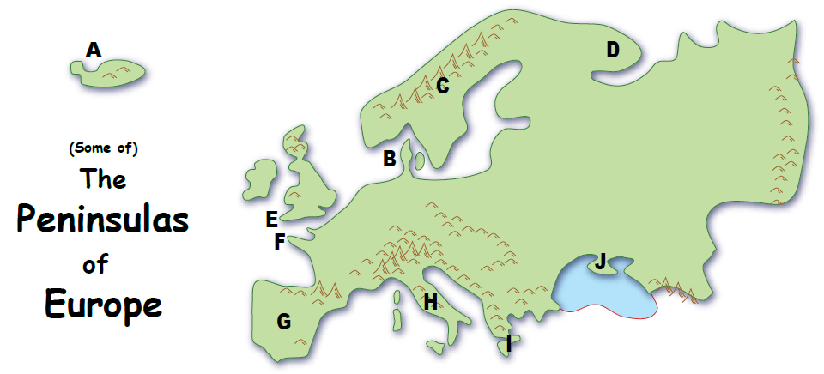
Introduction to 3rd activity:
Hint: Use the compass rose.
North
West
East
3rd activity
- - - - - - - - - -
Match descriptions to map locations.
South
Students should use the worksheet called
The Peninsulas of Europe - Answer the questions.

