Slide 1
Population A geographic “BIG IDEA” with many consequences IN china
Grade 6, U2, L2, S1, b1
Population density helps us understand many other geographic features in China,
including patterns of crop production,
dynasties, inventions, large building projects,
highways, factories, trade, pollution, disease, and human rights.

Slide 2
Section 1: Introduction to China's large population Comparison of China and the U.S.

Slide 3
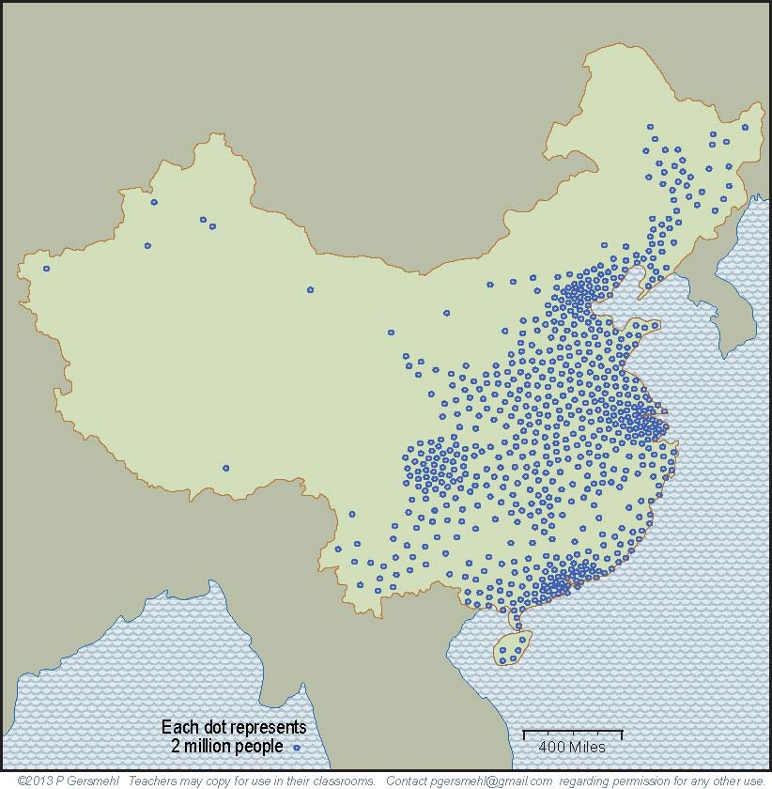
China is a good choice as a “lab”
to study consequences of population density,
because it has had a large population for 2000 years.
Show the densely populated
region
on an outline map
of China.
- - -
Where are people
most crowded together inside China?

Slide 4
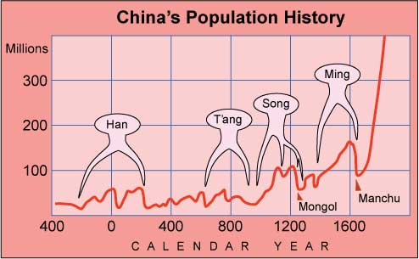
There were at least four times in China’s history
when the country lost more than a third of its population to warfare, disease, or starvation.
China had to provide safety and food for very large populations!
What
happened
after 1600?

Slide 5
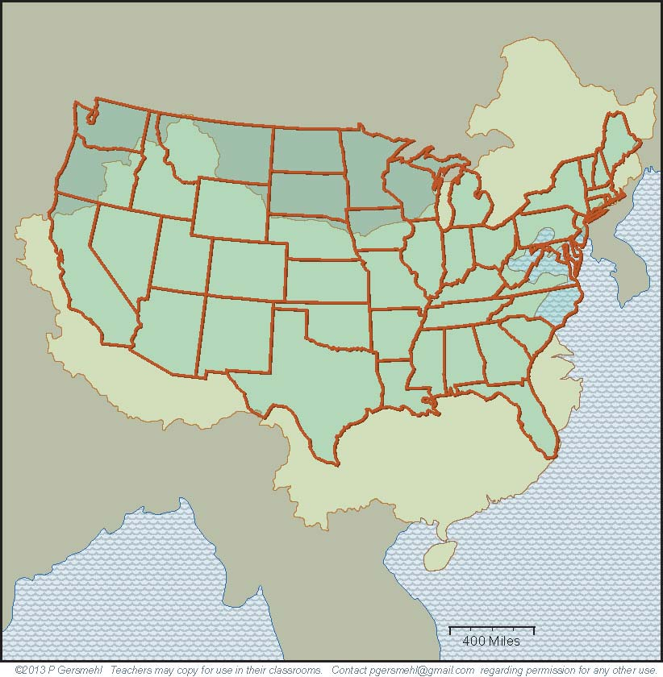
China has about the same area as the United States,
but it has more than four times as many people.
Both countries
cover roughly
the same latitude
and general position
on the east coast
of their continents.
As a result,
many of the environments
in China
are similar to
places in the
United States.

Slide 6
There are also
several important differences
in environmental conditions.
WA
For example, China does not have an ocean next to its western side.
China's western side is dry.
(In U.S. western states, winds from the ocean next to them bring rain for farming.)
Therefore, China has no places like California (CA), Oregon (OR), or Washington (WA).
OR
CA
And remember,
California is by far
the number one
food-producing state
in the United States.
Notes:
Differences

Slide 7
Another huge difference:
China does not have
anything like
the Great Lakes.

Slide 8
Manchuria
Mongolia
As a result, China’s “northlands”
(Mongolia and Manchuria)
are much colder and drier
than areas in the U.S. that are near the Great Lakes.

Slide 9
The Great Lakes
are a big benefit
for food production
in the United States.
China does not have
a large region
of prime farmland
like the Corn Belt
in the Midwest.

Slide 10
Section 1 Review: Where does most of China's large population live? How does China differ from the U.S.? Compare land area size. . Compare population. . Compare having water bodies that help provide rainfall for farming.

Slide 11
Section 2: China's major rivers China's major urban areas

Slide 12
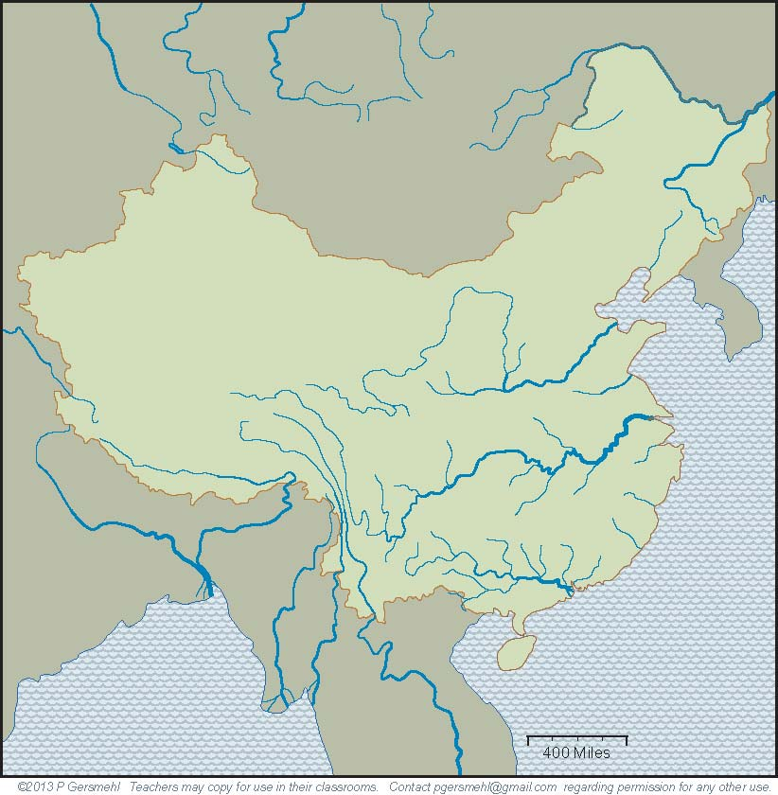
What China does have is four major river systems.
Label four rivers
on an outline map
of China.
The Amur
on the border
with Russia.
The Huang He -
“He” means
muddy river.
The Yangtze Jiang -
“Jiang” means
clear blue river.
The Zhu Jiang -
(also known
by an English name,
the Pearl River).

Slide 13
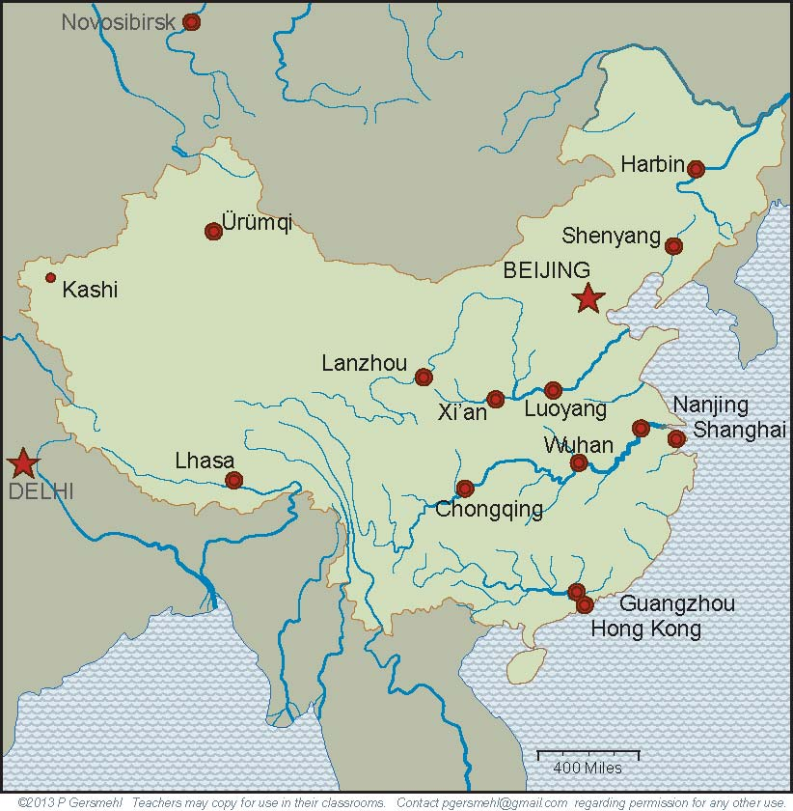
The floodplains of the Huang He have had
large populations throughout Chinese history.
The old capitals
of Luoyang
and Xi’an
are on the
Huang He.
Place the 2 ancient capital cities
on the outline map of China.

Slide 14
The floodplains of the Yangtze and Pearl Rivers also have had large populations throughout Chinese history.
Four great cities
are spaced along
the Yangtze.
Guangzhou (Canton) and
Hong Kong are near
the mouth of the Pearl.

Slide 15
Today, there are four major
urban areas
with especially large populations.
Place 4 large urban areas
on the outline map of China.
Beijing
Chongqing
Nanjing,
Shanghai
Guangzhou,
Hong Kong

Slide 16
Section 2 Review: Why are China's rivers important? Where are the Huang He, Yangtze Jiang, and Zhu Jiang (Pearl)? Where were ancient capital cities located? Where are today's major urban areas located? Where does most of China's large population live?

Slide 17
Section 3: Different regions inside China: Crop regions Climate regions

Slide 18
Different ruling dynasties
had their capital cities in different regions.
.Imagine being in a country where the capital city moved every few hundred years, and sometimes more often!
Different regions have different resources.
They were powerful enough to rule China at different times.

Slide 19
Chinese history
is very long and complex,
but under it all is a geographical story.
Different parts
of China
have had
different
economies,
lifestyles,
and cultures.
We'll look first at different types of farming economies.

Slide 20
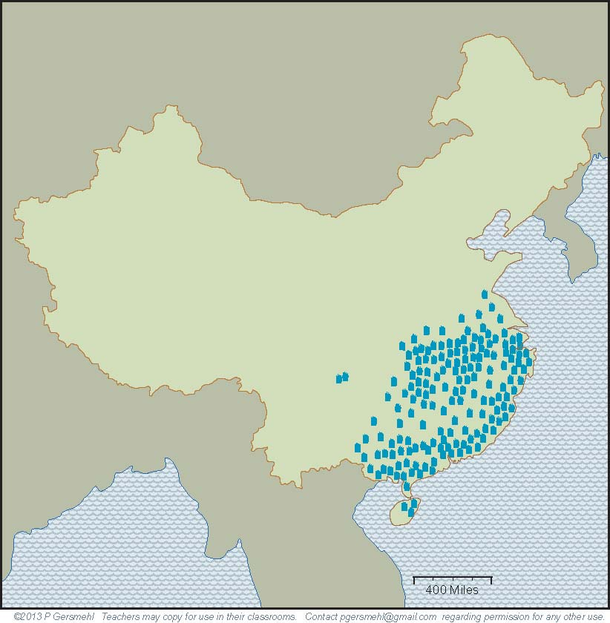
Different parts of the country
have different farming economies.
Show the
"2 crops of rice" region
on an outline map
of China.
The southern region
has a long summer and the most precipitation.
Farmers here can grow
two crops of rice,
In one year.

Slide 21
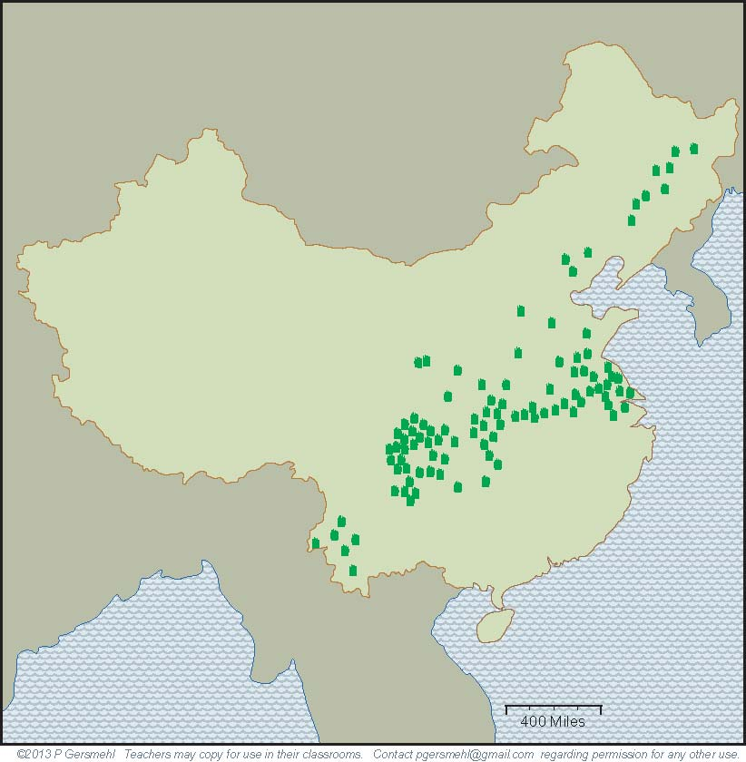
Rice
Describe where the "1 crop" region is
compared with the "2 crop" region.
To the north and west,
the growing season
gets shorter, and there is less rainfall.
Farmers can harvest
only one crop of rice
in a typical year.

Slide 22
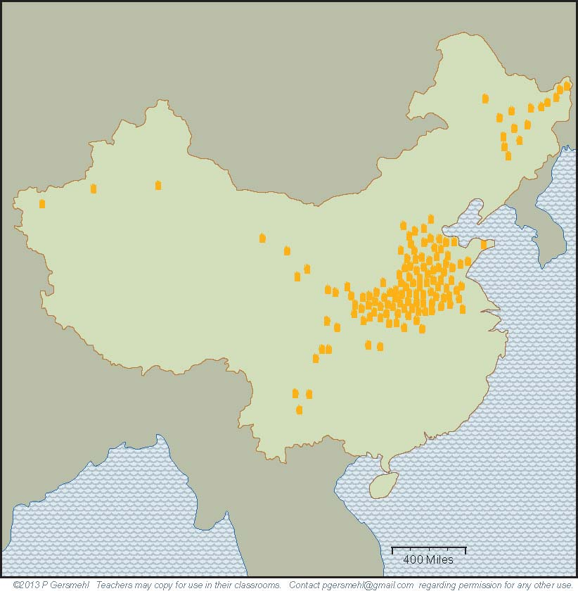
Show the
"wheat and millet" region
on an outline map
of China.
Still farther north,
on the floodplain
of the Huang He,
wheat and millet are
the preferred crops,
but drought is a risk
(in years when the river
does not flood!)

Slide 23
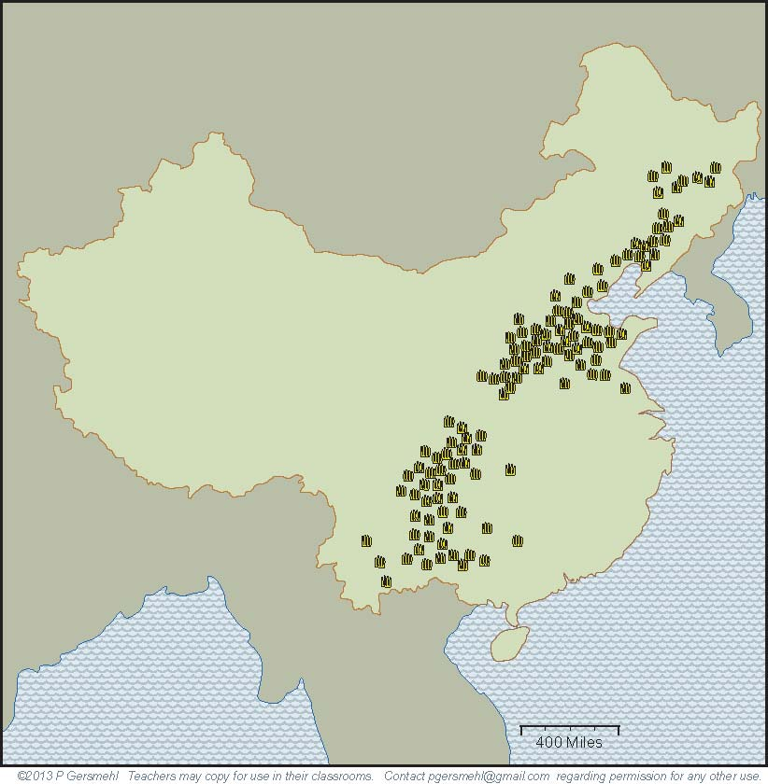
The "corn" region
is near other crop regions.
Farther inland,
corn has recently become widely grown.
It has the same use
as in the United States
(as feed for pigs).

Slide 24
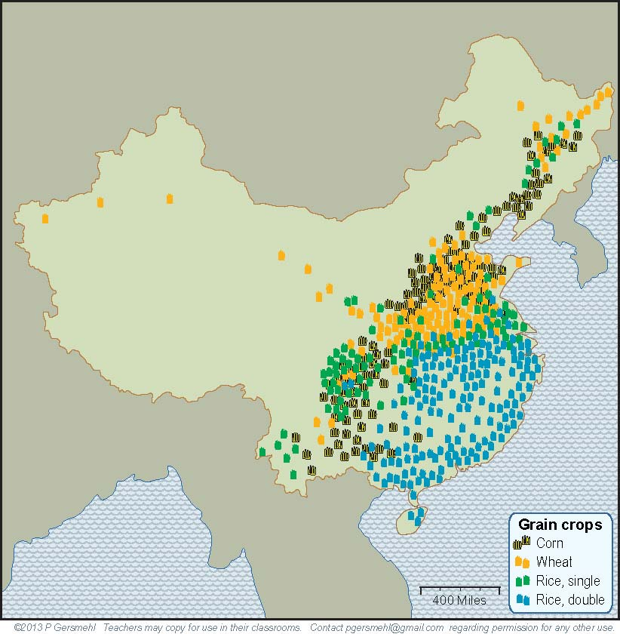
When we show all four crops
on one map,
there is
some overlap,
but you still see
distinct regions.

Slide 25
This map shows amount of precipitation.
DRY
DRY
On the China outline map, label
the lowest precipitation area (DRY)
and the highest precipitation area (WET).
Low precipitation
DRY
High
precipitation
WET

Slide 26
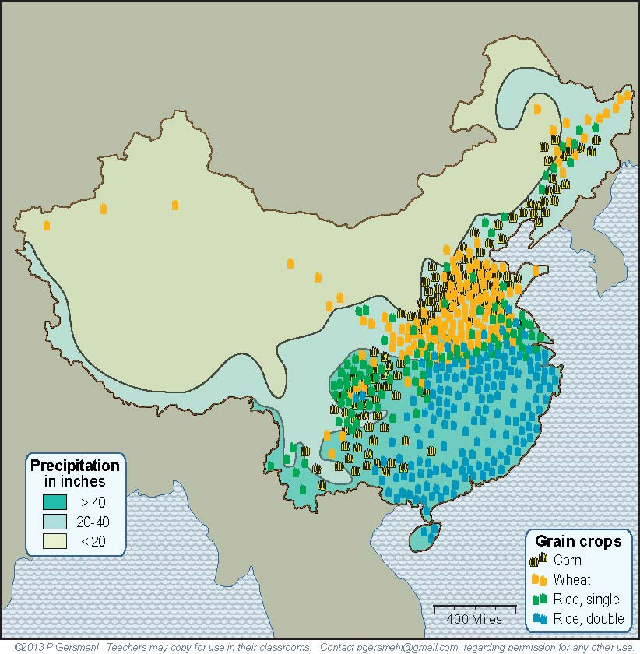
Northwestern China is generally dry, with only a few small areas of irrigated farming.
The DRY northern and western half of China
also has very few people..
DRY
DRY
DRY

Slide 27
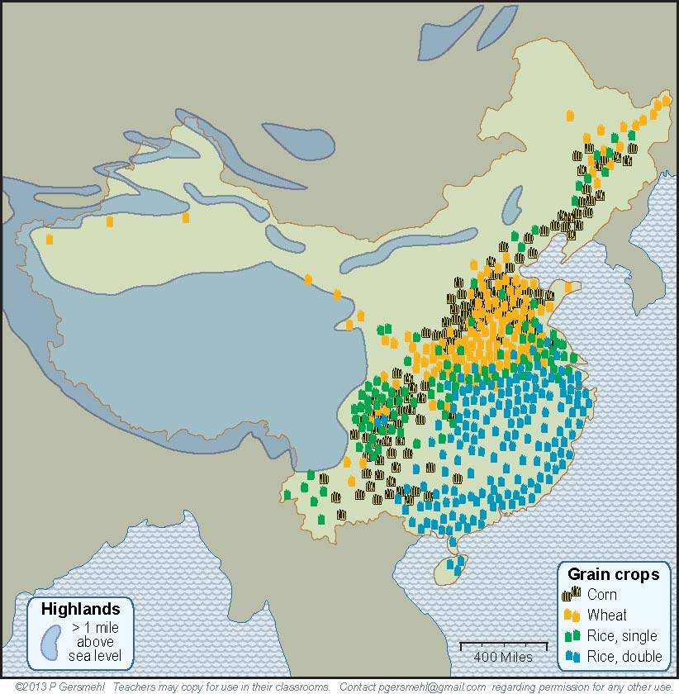
The southwestern area
has another problem - very high elevation.
These cold mountains have very little land
that is suitable for crop farming.
On the China outline map, label
the high, cold region.
HIGH and
COLD

Slide 28
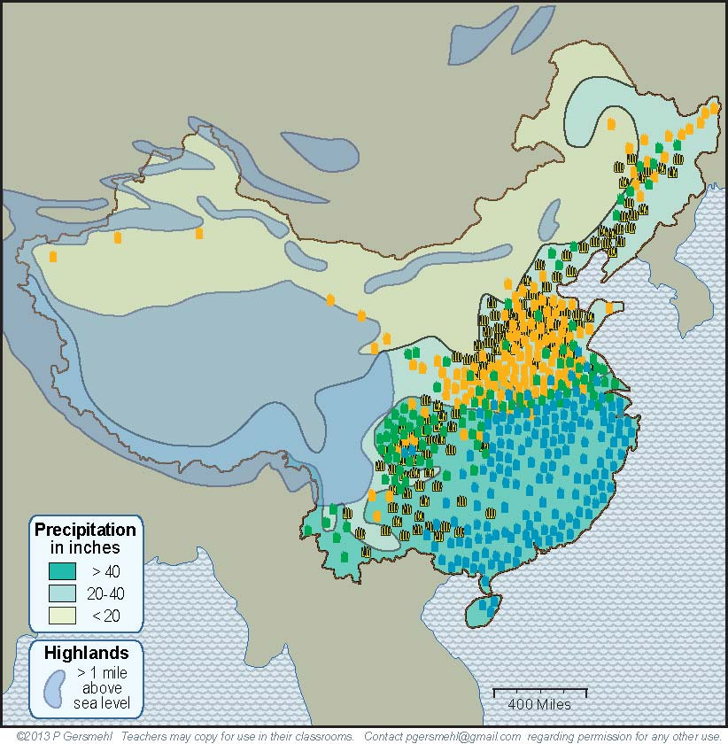
This map shows
the high areas
and the dry areas.
China has only about half
as much good cropland
as the United States.
DRY
HIGH

Slide 29
Remember, China does not have
an ocean on its west side.
China
does not have
a Great Lakes
farming region.

Slide 30
Section 3 Review: China has several different regions: Climate regions: Which part of China is most dry? Which part of China is coldest? In which climate region do most people live? Crop regions: Where is the region where farmers can grow 2 crops of rice in a year? Where is the region in which farmers mainly grow wheat?

Slide 31
Section 4: Consequences of China having a large and crowded population Huge building projects, Inventions, Trade

Slide 32
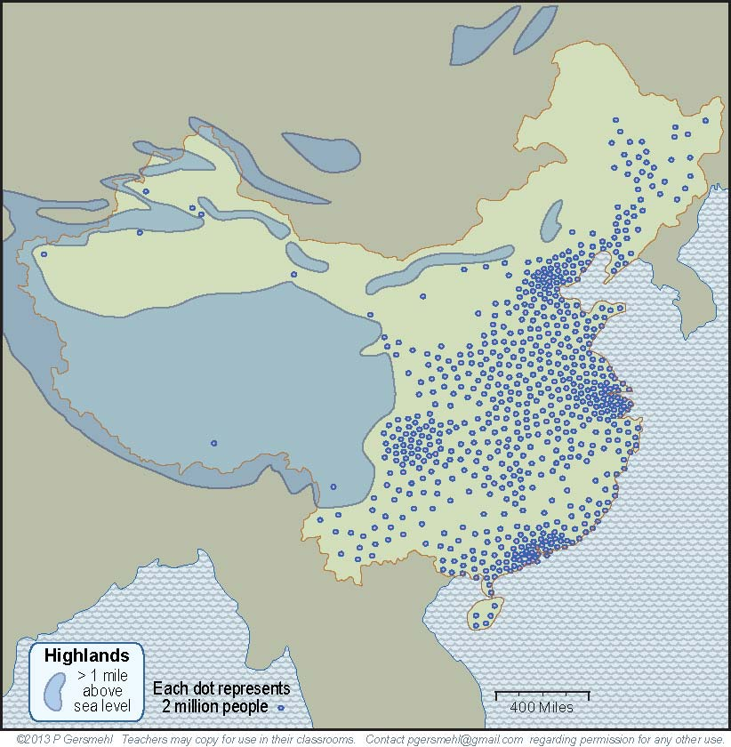
With all of this
as background,
it is easy to see
why the population
is crowded together
in about one-third
of the country.
NEXT:
What are some
consequences
of a having a large but crowded
population?

Slide 33
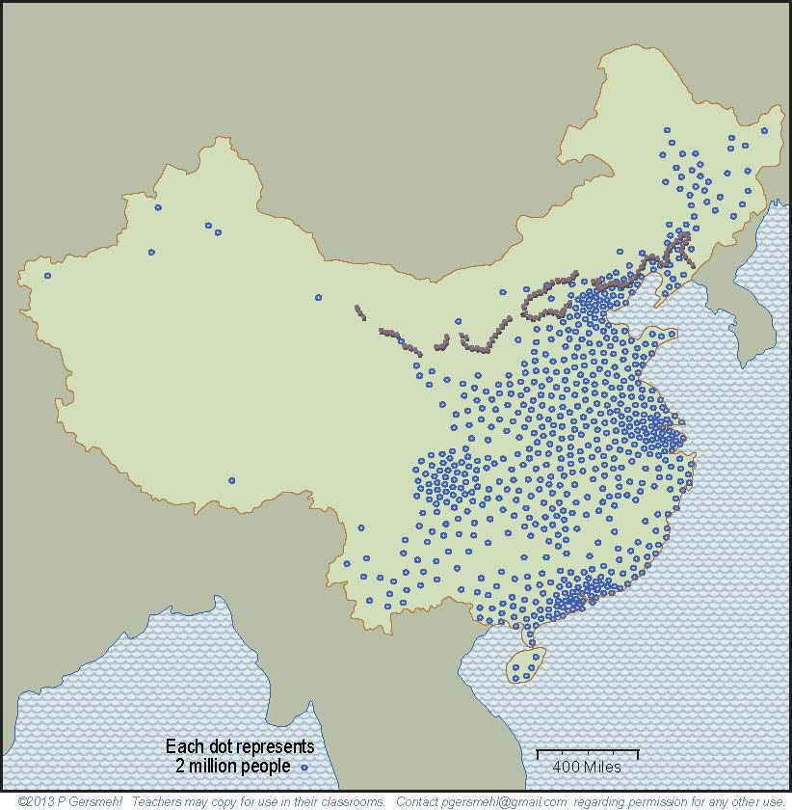
A large population
(if people work together)
can plan and accomplish
huge building projects.
Here is the famous
Great Wall of China.
Chinese rulers
started building a wall
more than 2000 years ago.
On the China outline map,
draw and label
the
"Great Wall."
They wanted to protect farm villages
from nomadic people
who lived in the cold
and dry country
to the north.

Slide 34
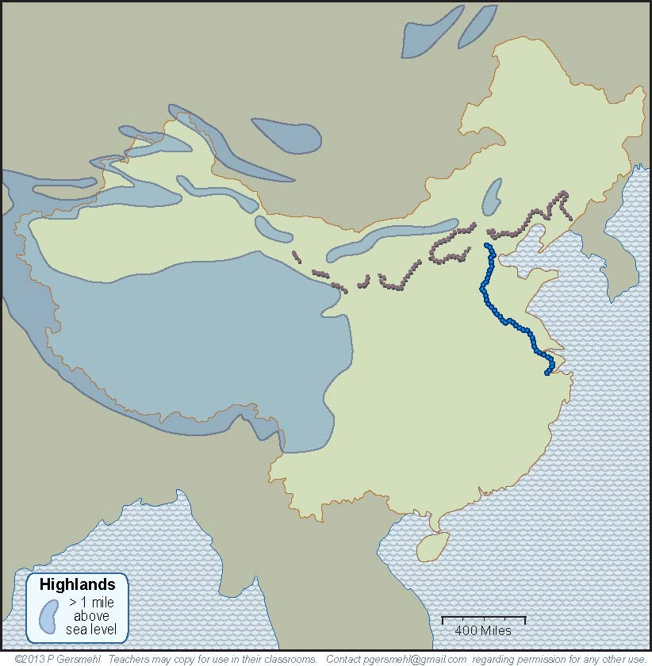
Draw and label the
"Grand Canal" on an outline map
of China.
Another important
early project
(also started 2000 years ago!)
was the Grand Canal.

Slide 35
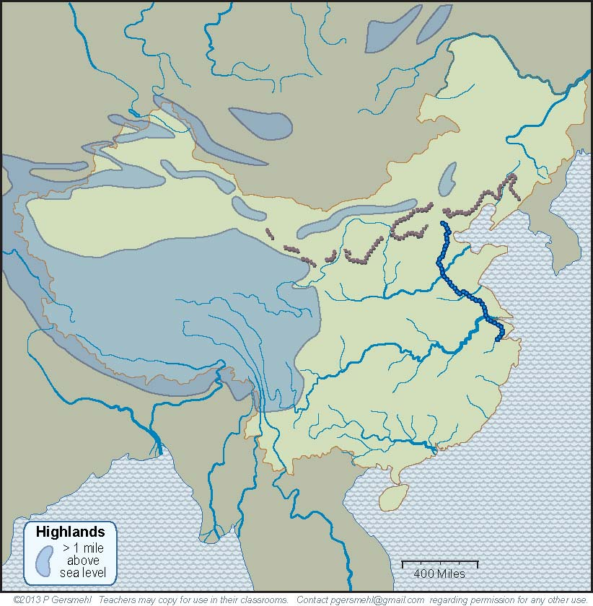
Textbooks usually
describe this canal
as a way for ships
to go between the
two large rivers.

Slide 36
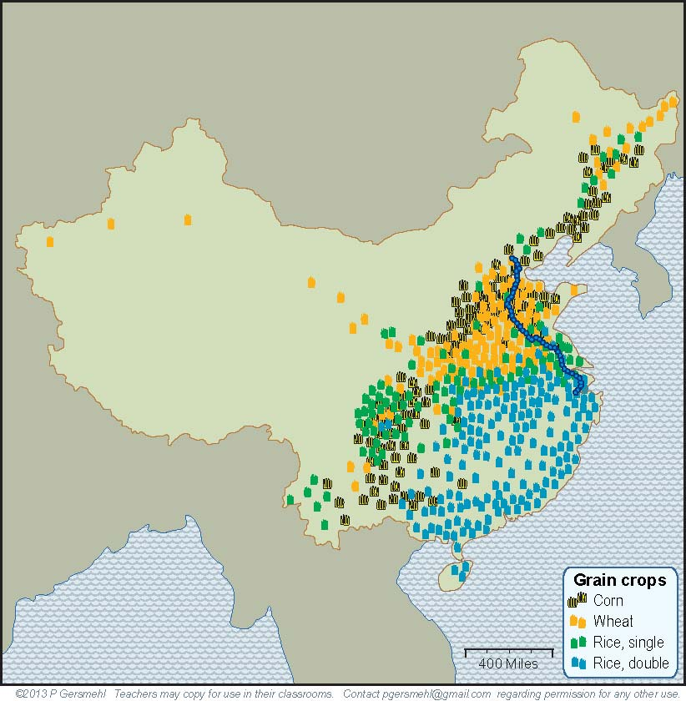
China has needed to feed its large population.
The real purpose
of this long canal,
however, was to
connect regions
that could grow different crops.
If one area had
a crop failure,
people could
use the canal
to move food
from other areas.

Slide 37
What are some other consequences
of having a large population?
A large population is likely to have a lot of smart people
who can invent things.
On the internet,
you can find
many lists
of important
Chinese inventions:
including
silk cloth, paper, porcelain, magnetic compass, gunpowder, and rockets.

Slide 38
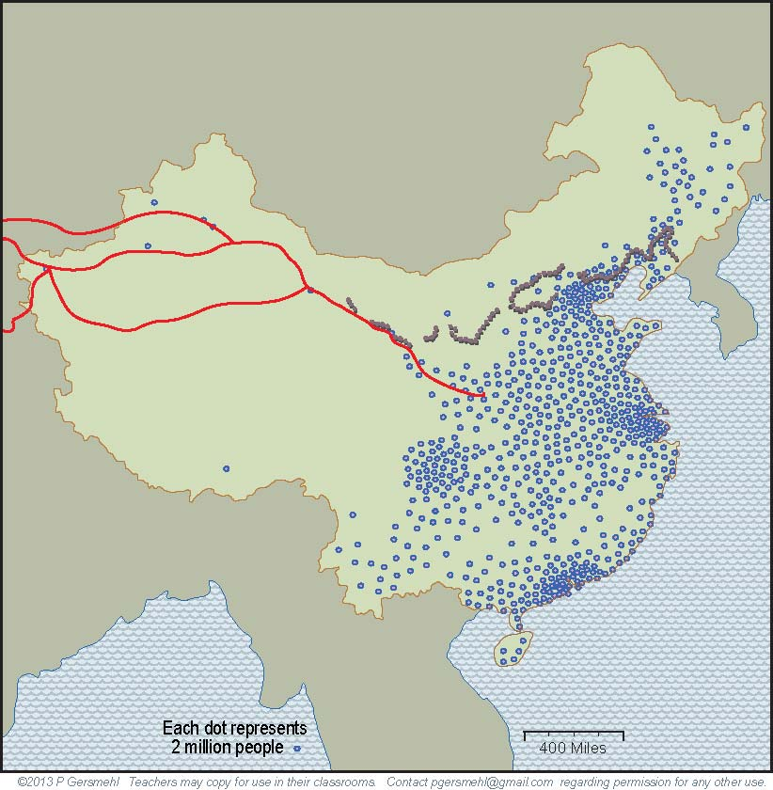
Silk was an early and valuable Chinese invention.
Silk was so important
that it gave its name
to trading roads
that went all the way
to Europe and Africa,
2000 years ago!
Silk Roads
Roman rulers
tried to limit
the amount of silk
people could wear. They thought
people were spending
too much money buying
imported silk from China!
Does that idea sound familiar?
Part of the Great Wall
was built to protect
the Silk Road traders
from attacks by bandits.

Slide 39
The Silk Roads illustrate another consequence
of a large population.
People in China wanted
to trade products
that they made
in order to get
resources they needed
(like horses in ancient times,
or oil today).
Silk Roads

Slide 40
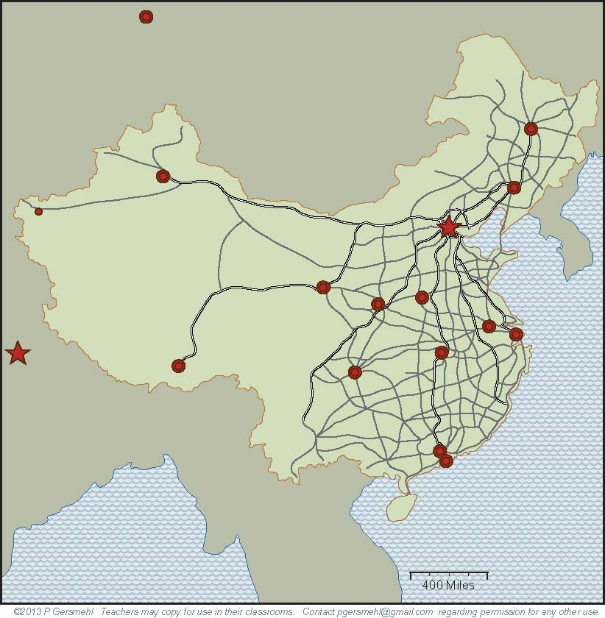
Remember the point
about large populations
being able to do
large building projects?
In just a few years, China has built
a network of highways
with as many miles
as the entire system
of Interstate Highways
in the United States.
(It took nearly 40 years to
build the American system.)

Slide 41
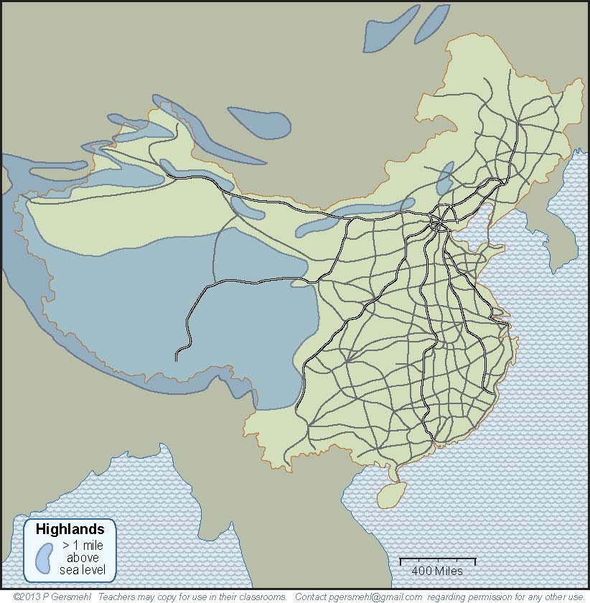
A map of this road system clearly shows how China
is divided into a nearly empty West and a crowded East.

Slide 42
Section 4 Review: -- Consequences of China having a large and crowded population: -- Huge building projects: Why did Chinese rulers bring people together to build the Great Wall and the Grand Canal? Inventions and Trade: What valuable cloth did the Chinese produce? How far away did traders carry it to sell?

Slide 43
Section 5: - Summaries - Other consequences of China having a large population

Slide 44
Large populations crowded together
have other consequences.
These include
more use of resources,
greater risk of air and water pollution,
origin and rapid spread of disease,
and many complicated effects
on personal freedom.
(We will discuss these topics in Units 3 and 5.)

Slide 45
Population density affects:
Construction – large, dense populations can provide
plenty of workers for large building projects
Innovations – large populations are more likely to have
many thinkers, artists, inventors, etc.
Military strength – large, dense populations are harder
to attack, because they can have an army with more defenders
Resource use – large, dense populations demand
more resources to maintain the same living standard
Pollution and disease – large, dense populations make
more pollution, and diseases can spread quickly
Personal freedom – large, dense populations often allow less
freedom to act without having an effect on others

Slide 46
The big challenge for China
is to maintain economic growth
while limiting the pollution and other side-effects
of crowded populations.
In the 1970s, the Chinese government
decided to try to limit the growth
of population in the country.
The government made a law
that made it illegal for most families
to have more than one child.
Our literature connection (Chu Ju's House) tells us more about China's One-child Policy.

Slide 47
This law (the “one-child policy”)
helped trigger an economic boom,
by making it possible for people
to invest money in businesses
(rather than spending it to feed children).
Today, this policy adds to the challenge,
because the population is aging.
Every year, there are more old people
for every younger worker to help support.
(The one-child policy
reduced the number of younger workers who were added to the population.)
We will use maps and Population Pyramids to look at number of children in relation to older ages in a country.

Slide 48
A large population country can also challenge
other countries.
---------
For example,
the rising wealth of China
allows its companies to buy more and more
of any resource that is in short supply,
such as oil, wood, metal ores, or water.

Slide 49
This presentation helps us investigate some consequences of the big idea of
population density, with examples from China.
PowerPoint prepared by
Phil Gersmehl & Carol Gersmehl
carol.gersmehl@gmail.com for the Grade 6 GIANTS project Oct., 2016
Maps in this presentation come from
the China clickable mini-Atlas.

